Slide 1
Understanding Data Flow Diagram with Power Designer
Software Engineering (IT314)
Lab – 06 (21st March, 2022)
TA:- Mahir, Vaishnavi
Course Instructor: Prof. Jayprakash Lalchandani

Slide 2
Definition
A Data Flow Diagram is (DFD) is a graphical representation of the “flow ” of the data in your system
OR
A data flow diagram looks at how the data flows in your system.
It concerns about the things like, how the data will come from and how the data will go and how the where will the data be stored as well.
DFD does not tell about the processing of the information(i.e. Whether the processes happen in sequence or in parallel manner)

Slide 3
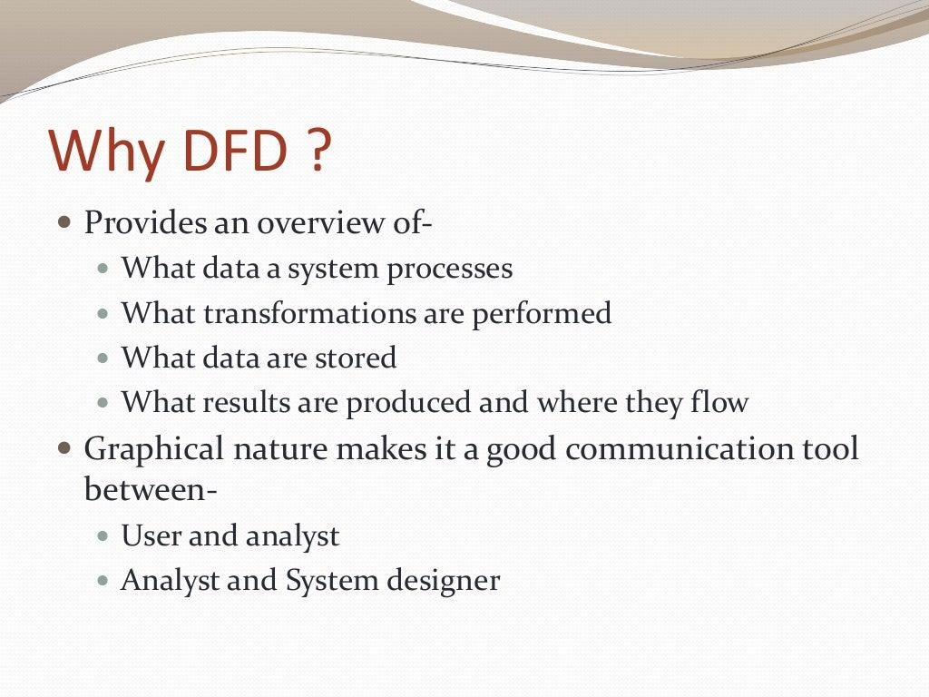
WHY DFD?

Slide 4
DFD is not FlowChart
Flow Charts show “Flow of Control”
DFD shows “Flow of Data”
FlowChart describes boxes that describe computations, decisions, interactions and loops

Slide 5
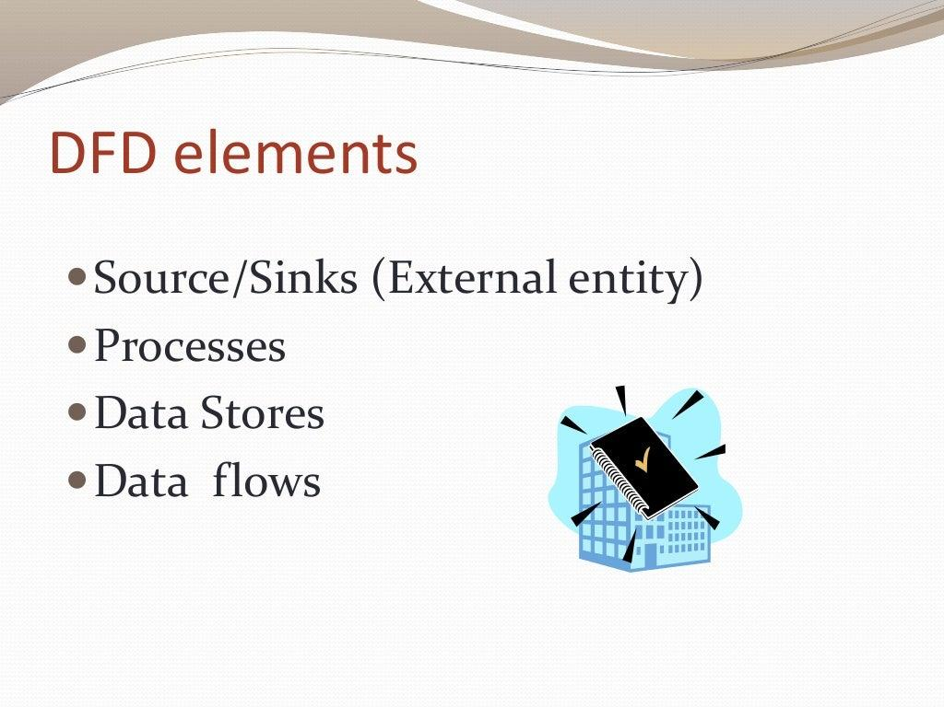
DFD Elements

Slide 6
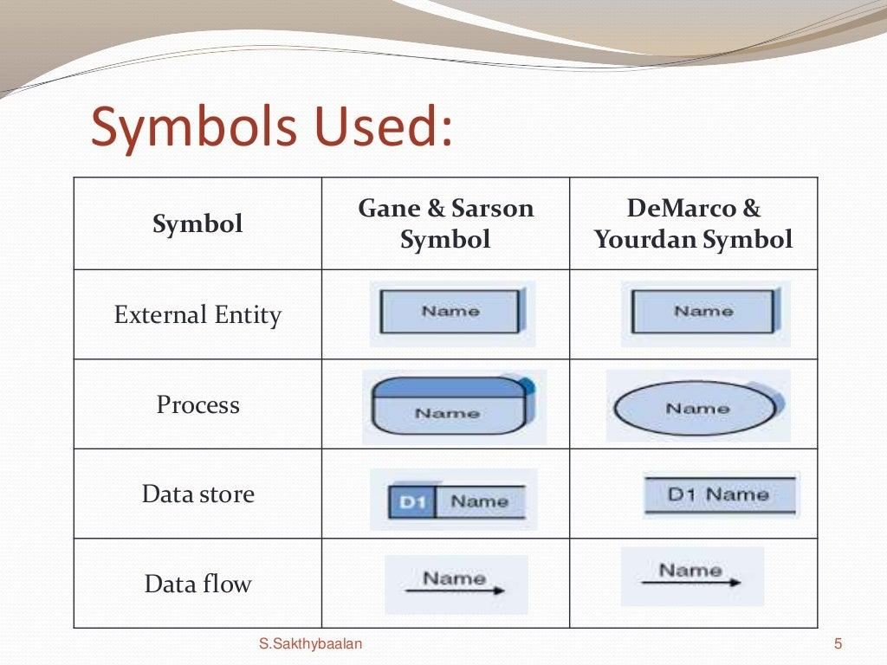
Symbols Used

Slide 7
Descriptions
External Entity: people or organization that sends data into the system or receives data from the system
Process: It shows that what happens to the data
I.e. It transforms the incoming data into the outgoing data, by performing some operations.
Data Store: Represents the permanent data that is being used by the system.
Data Flow: It models the actual flow of the data between the other elements.

Slide 8
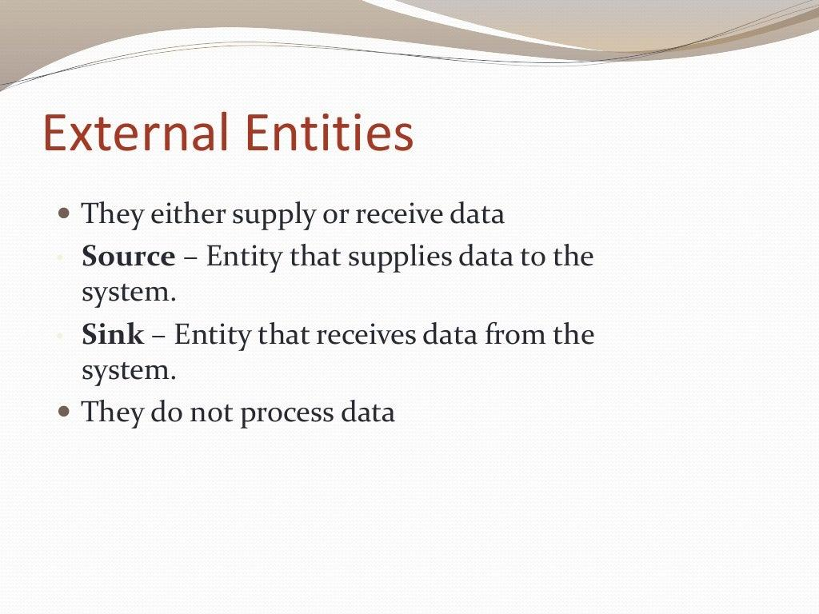
External Entity

Slide 9
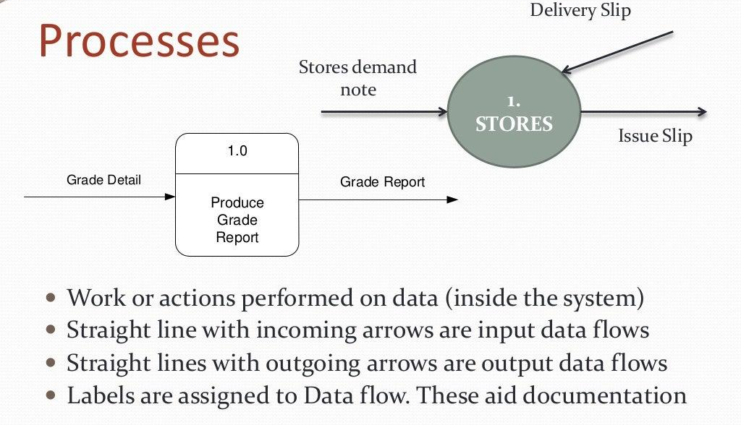
Process

Slide 10
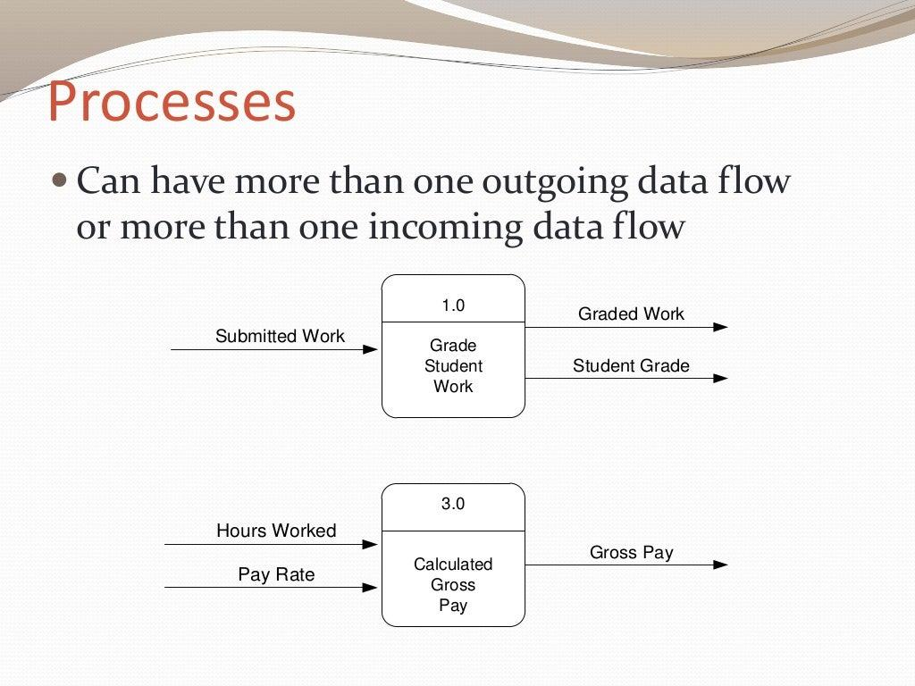
Processes

Slide 11
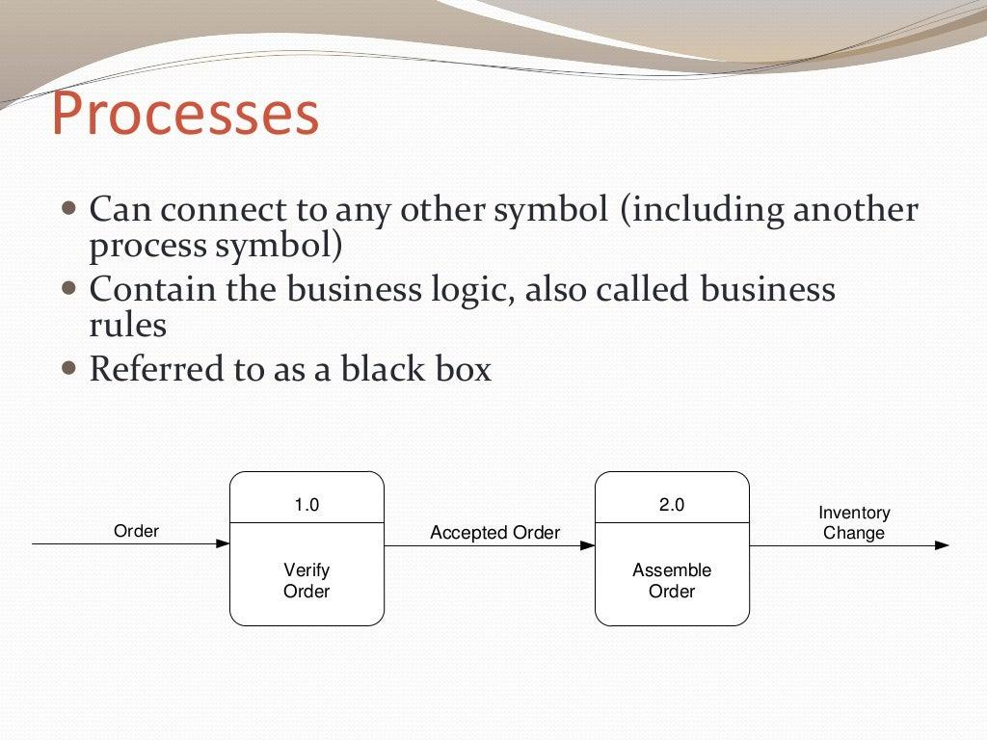
Processes

Slide 12
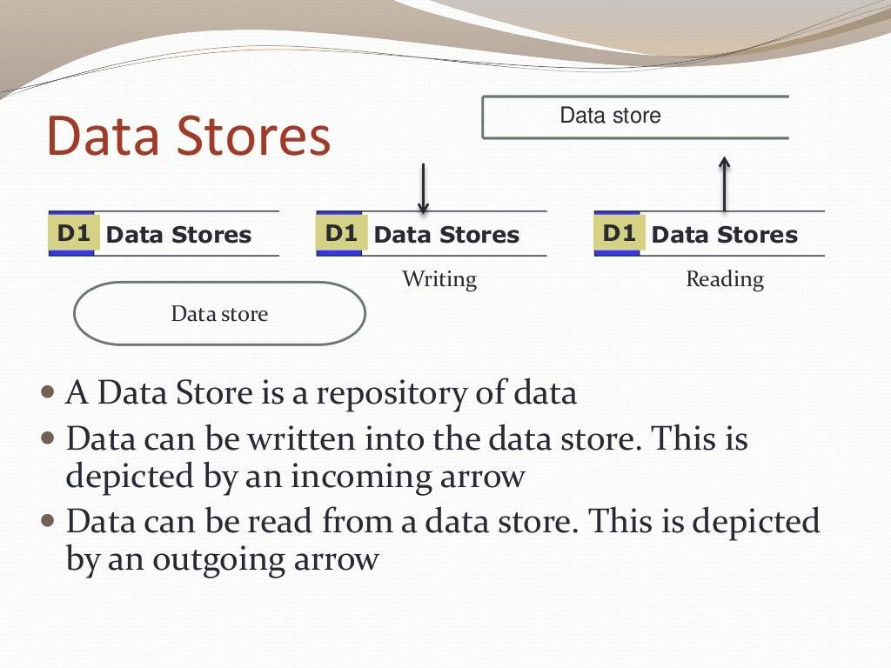

Slide 13
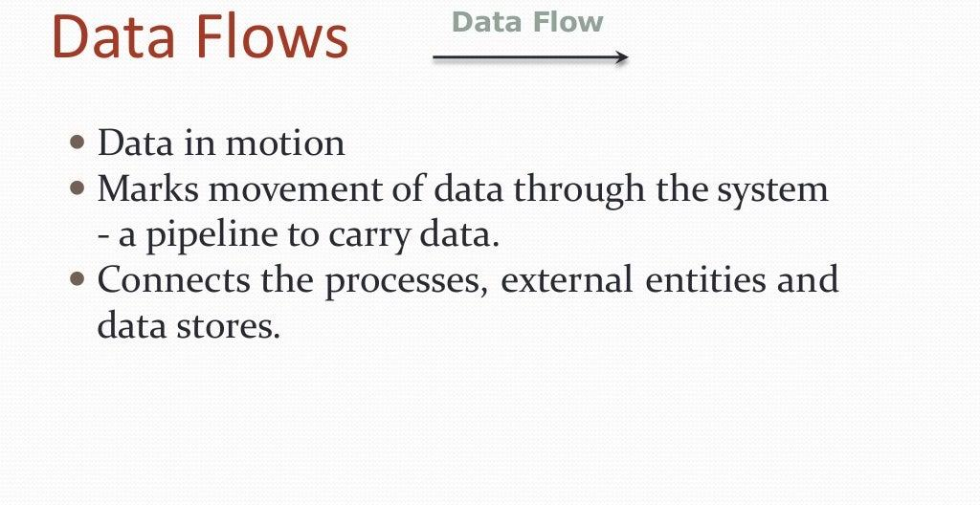
Data Flows

Slide 14
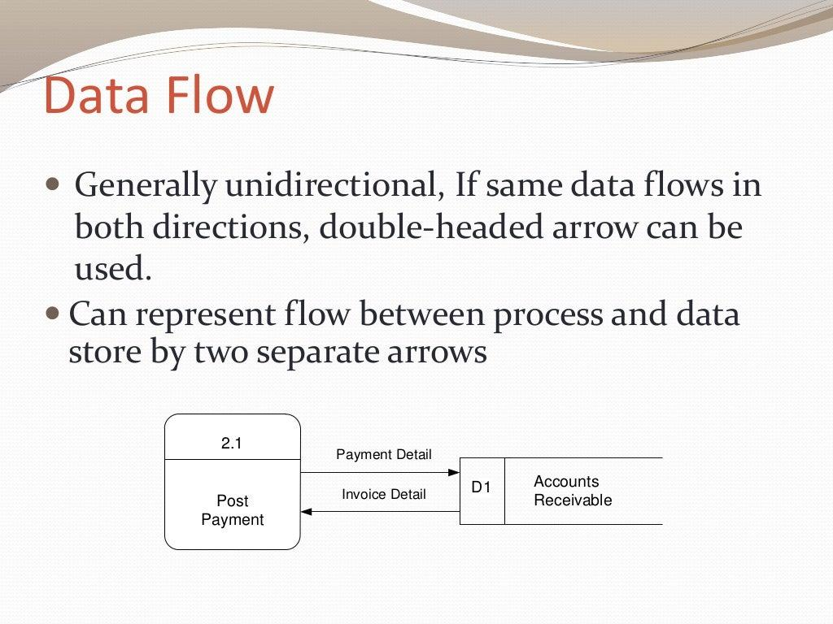
Data Flow

Slide 15
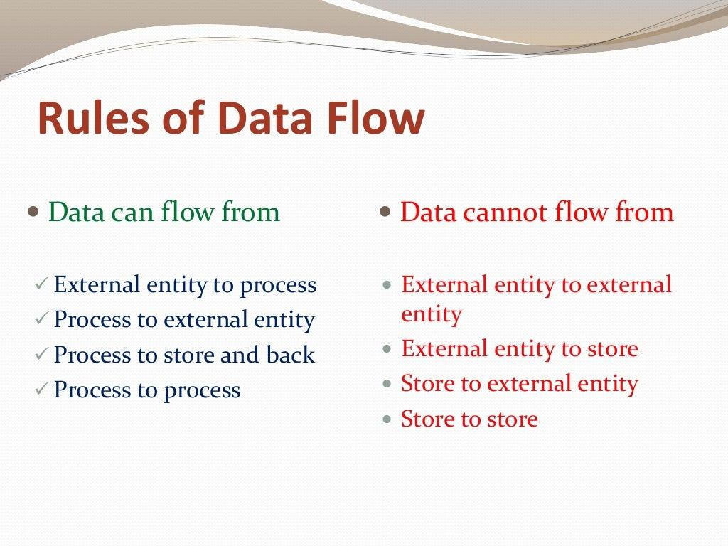
Rules of DataFlow
Data can flow from:
External entity to process
Process to external entity
Process to Process
Process to Data store and back
Data cannot flow from:
External entity to external entity
External entity to store
Store to external entity
Store to Store

Slide 16
Types of DFD’s
DFD’s are categorized as follows:
Logical DFD
Physical DFD
Logical DFD: A Logical DFD focuses on the business and the how the business operates. It describes the business events that takes place and the data required and produced by each event
Physical DFD: Physical DFD shows that how system will be implemented.

Slide 17
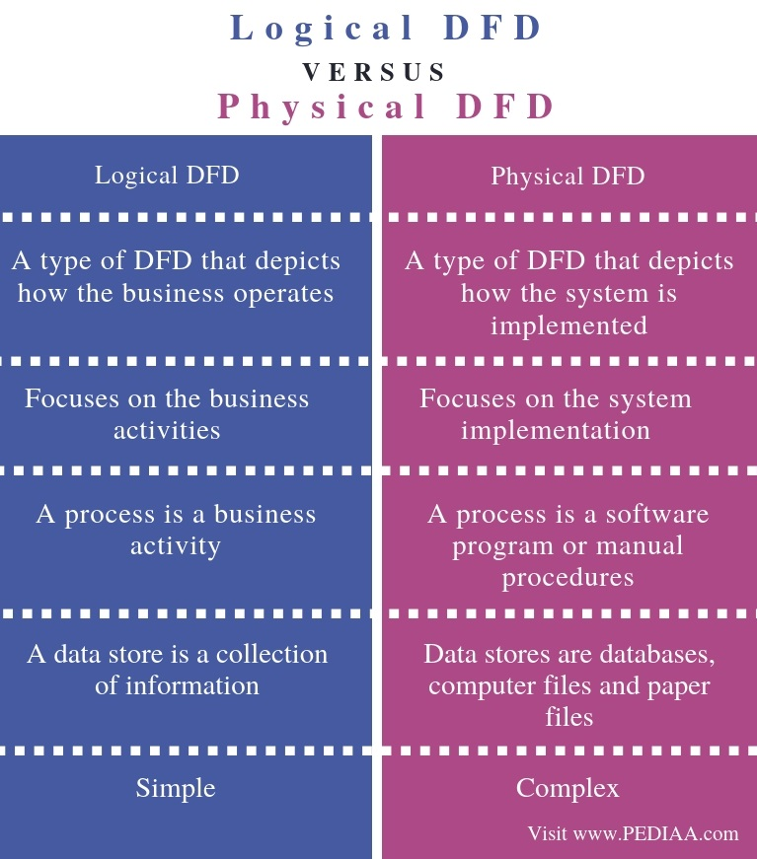

Slide 18
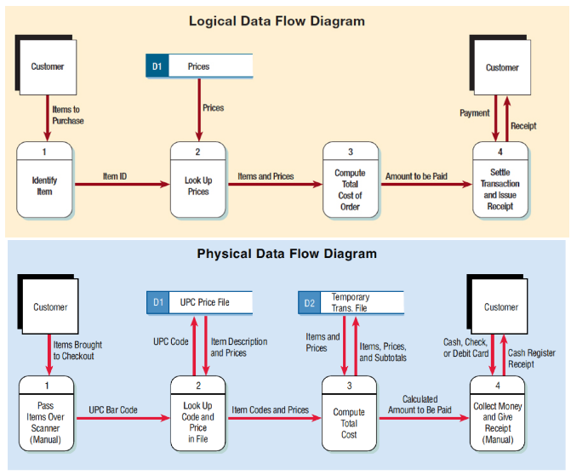
Example of Logical and Physical DFD

Slide 19
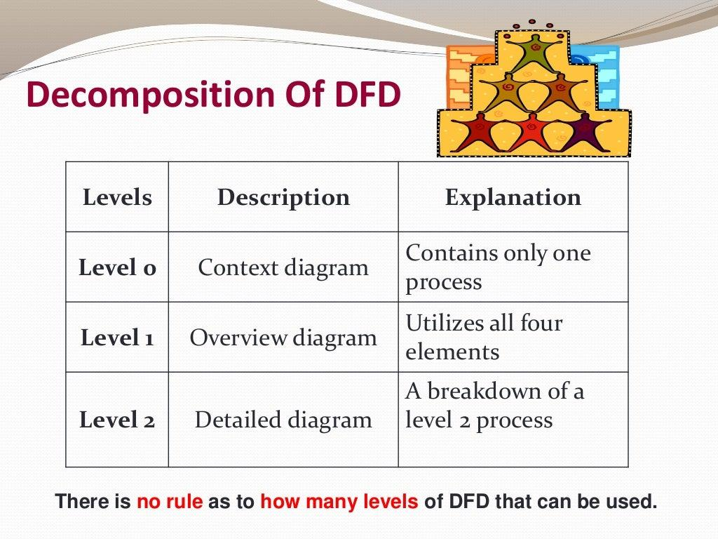
DFD Levels

Slide 20
Level - O DFD
Level - 0 DFD also known as the (context Level DFD ) is the simplest DFD
DFD Level- 0 is concerned with how the system interacts with the outside world
This level represents the input and output of the system
DFD Level-0 combines the sets DFD fragments into one diagram.
Generally moves from top to bottom and left to right.
It’s designed to be an at-a-glance view, showing the system as a single high-level process, with its relationship to external entities.

Slide 21
How to Create Level - O DFD
Identify your main system.
Identify the external people who will interact with the system
Decide what data will these entities enter into the system.
Determine what will be the output to these entities from the system.

Slide 22
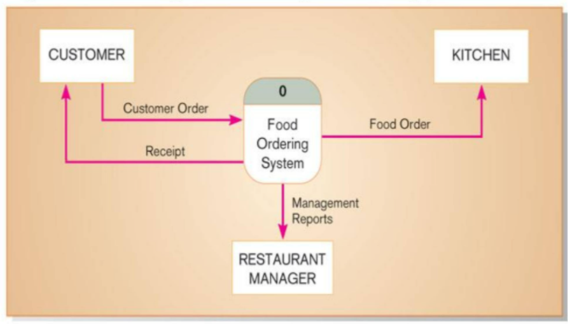
Example of DFD Level - O

Slide 23
DFD Level - 1
DFD Level 1 provides a more detailed breakout of pieces of the Context Level Diagram.
Basic modules of the system are shown in this level and how the data moves through these modules is shown in this level.
DFD Level - 1 provides a high level view of the system that identifies the major processes and how the data is stores

Slide 24
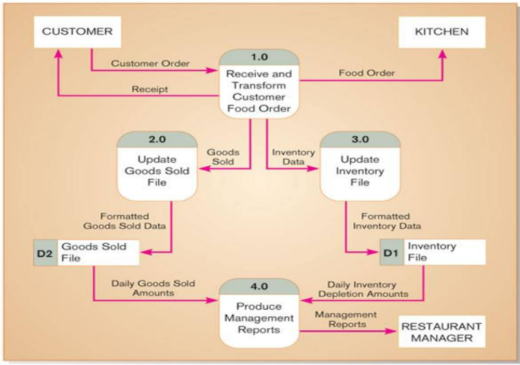
Example of DFD level - 1

Slide 25
How to create level - 1 DFD
Primary focus should be on the processes that will process the data
Identify what information will flow between the processes and what information will flow between the processes and the external entities.
Identify what information will be stored permanently in the data store for future use by the system.

Slide 26
Level - 2 DFD and further Levels
Each process from level - 1 is exploded even more into sub processes. This decomposition continues at each level.
DFD Level 2 then goes one step deeper into parts of Level 1. It may require more text to reach the necessary level of detail about the system’s functioning.
Number of levels possible depends on the complexity of the system.

Slide 27
DFD Balancing
The conservation of inputs and outputs to a data flow process when that process is decomposed to a lower level
Balanced means:
Numbers of inputs to lower level DFD equal numbers of inputs associated process higher-level DFD
Number of outputs to lower level DFD equal number of outputs to associated process of higher-level DFD

Slide 28
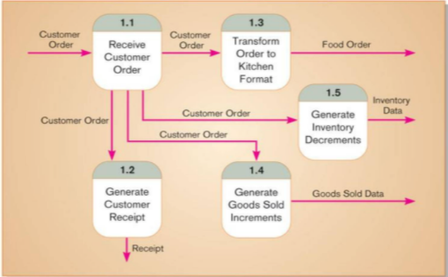
Level-2 diagram of decomposition of process 1.0 from level- 1
This are balanced because the number of inputs to outputs of process 1.0 of the Level-1 equals the number of outputs to Level-2 diagram.
1 Input
4 outputs

Slide 29
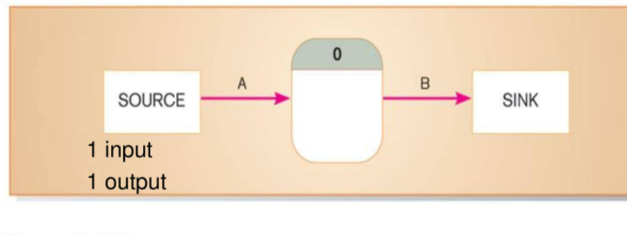
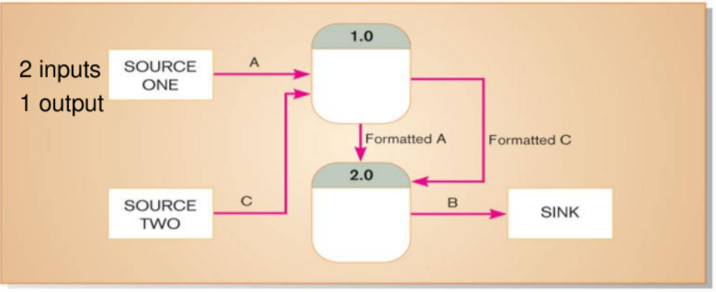
Unbalance DFD
This is unbalanced because the process of the level 0 diagram has only one input and level 1 has two inputs

Slide 30
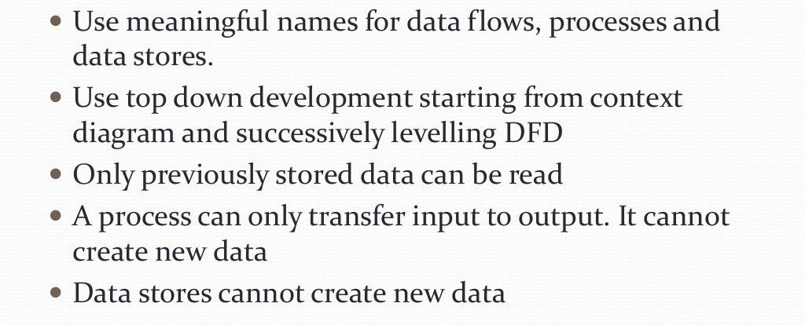
Good Practices for Drawing DFD

Slide 31
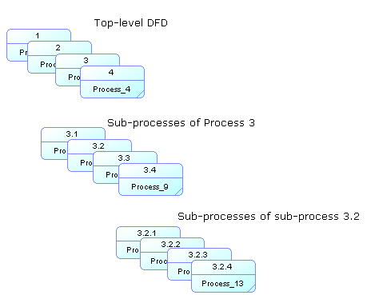
Numbering DFD Process
Numbering can be used in leveled data flow diagrams, where you decompose a process into lower level processes, to more closely analyze the various transformations carried out by the parent process.
Child processes inherit the number ID of their parent process, so that, for example, a top level DFD would have processes 1 2 3 4, the sub-process of process 3 would have processes 3.1, 3.2, 3.3, and 3.4, and the sub-process of the sub-process 3. 2 would have components 3.2.1, 3.2.2, 3.2.3, and 3.2.4:

Slide 32
Structure Chart

Slide 33
Module Structure Chart
Hierarchical structure of modules. It breaks down the entire system into lowest functional modules, describe functions and sub-functions of each module of a system to a greater detail.
Modules at top level called modules at low level.
Components are read from top to bottom and left to right.

Slide 34
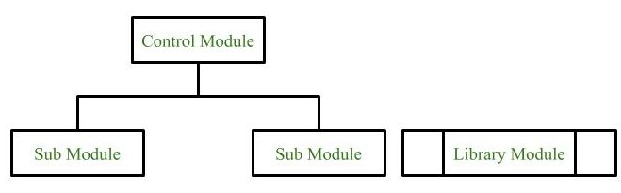
Symbols used for construction
Module
It represents the process or task of the system. It is of three types.
Control Module A control module branches to more than one sub module.
Sub Module Sub Module is a module which is the part (Child) of another module.
Library Module Library Module are reusable and invokable from any module.

Slide 35
2. Conditional Call
It represents that control module can select any of the sub module on the basis of some condition.
3. Loop (Repetitive call of module)
It represents the repetitive execution of module by the sub module. A curved arrow represents loop in the module.
4. Data Flow
It represents the flow of data between the modules. It is represented by directed arrow with empty circle at the end.
5. Physical Storage :-
Physical Storage is that where all the information are to be stored.
6. Control Flow
It represents the flow of control between the modules. It is represented by directed arrow with filled circle at the end

Slide 36
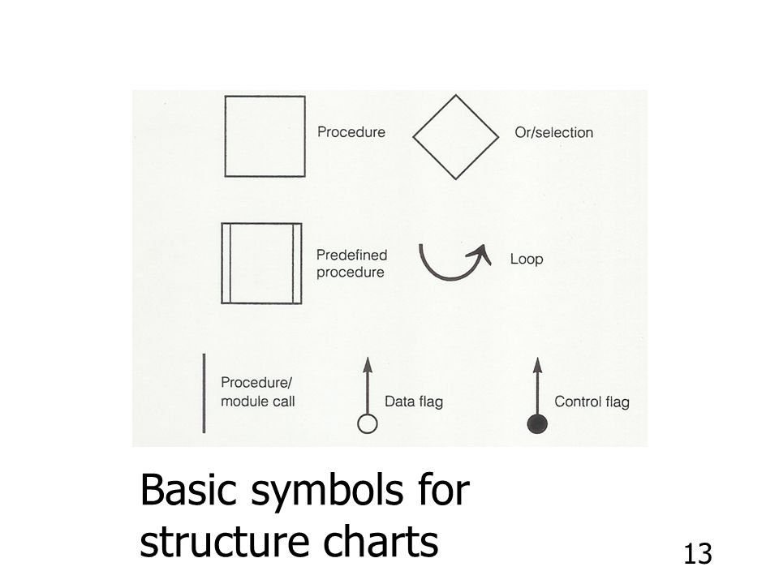

Slide 37
How Structure Chart Is Related To DFD
Structure chart is derived from Data Flow Diagram.
It represents the system in more detailed way than DFD, it breaks down the entire system into lowest functional modules, describes functions and sub functions of each module of the system to a greater detail than DFD

Slide 38
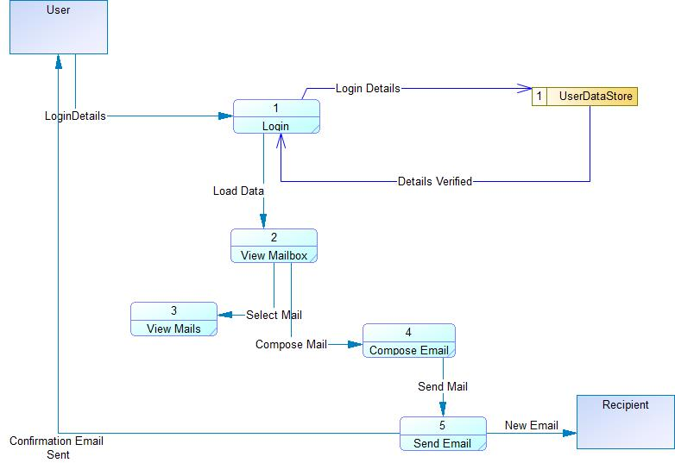
Example - DFD

Slide 39
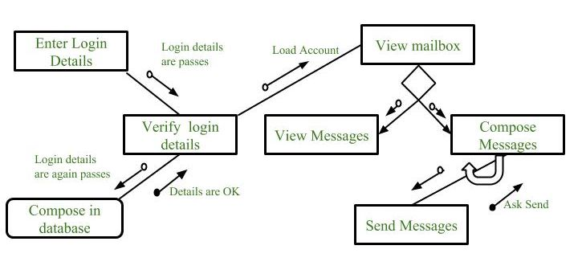
Example

Slide 40
PowerDesigner
DEMONSTRATION

Slide 41
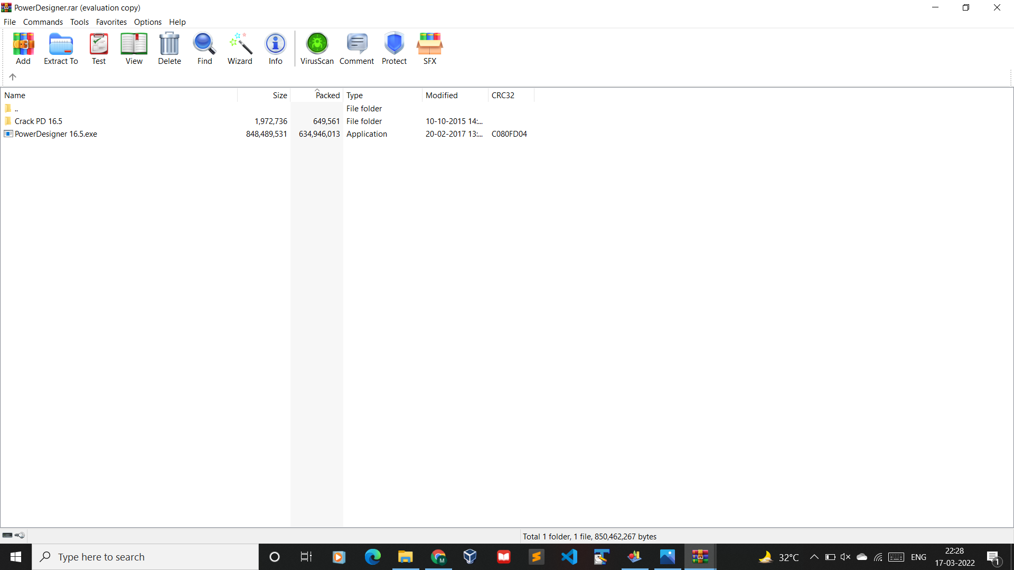
Download Link: https://mega.nz/file/DdVSjRxJ#ybrUOT4oHVKVsl1tdoo5DKh0IPMm1yDXIInW5chbf0Y
Download Link: https://mega.nz/file/DdVSjRxJ#ybrUOT4oHVKVsl1tdoo5DKh0IPMm1yDXIInW5chbf0Y
OR
https://drive.google.com/file/d/1hk8-sxWMAa918ct6klbR88q1zrEQe_6r/view?usp=sharing

Slide 42
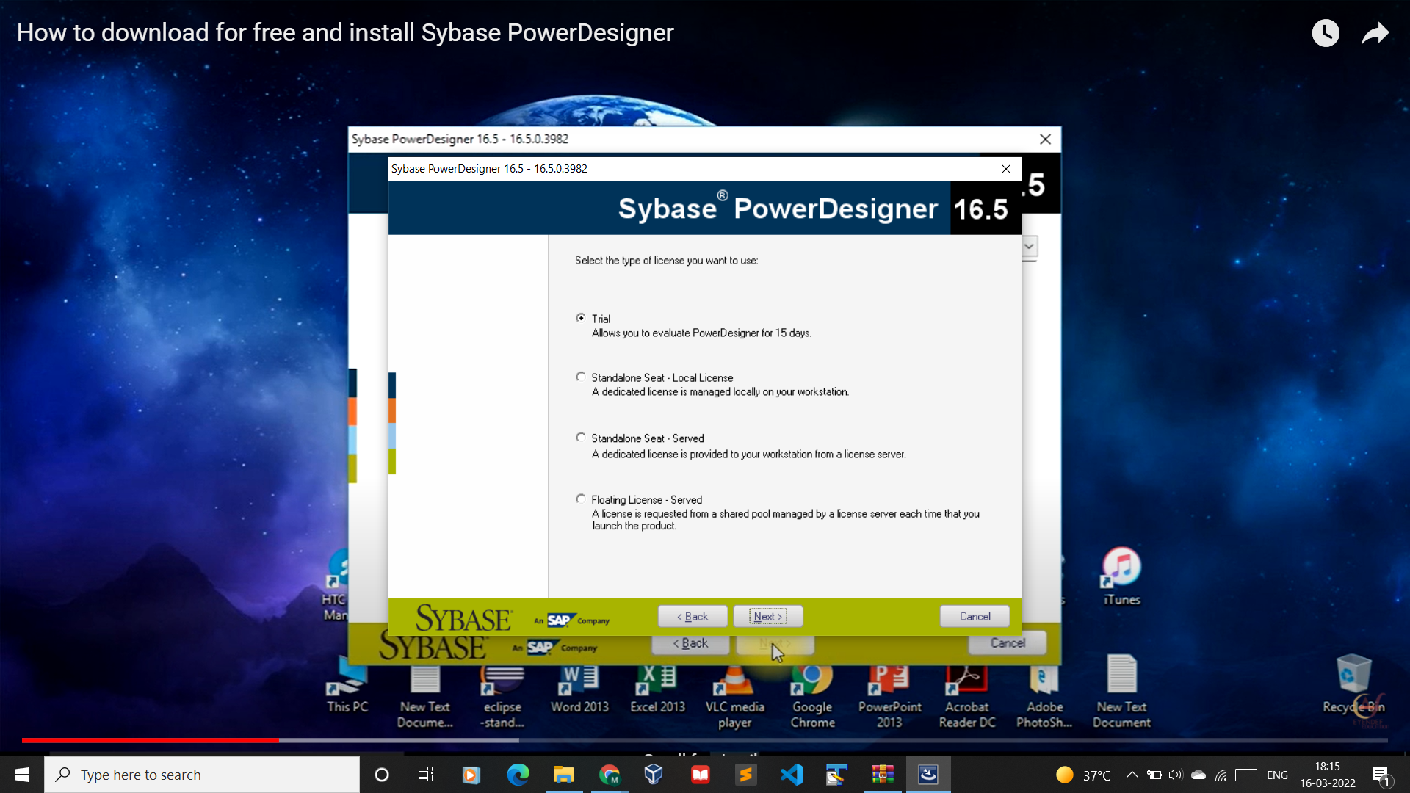

Slide 43
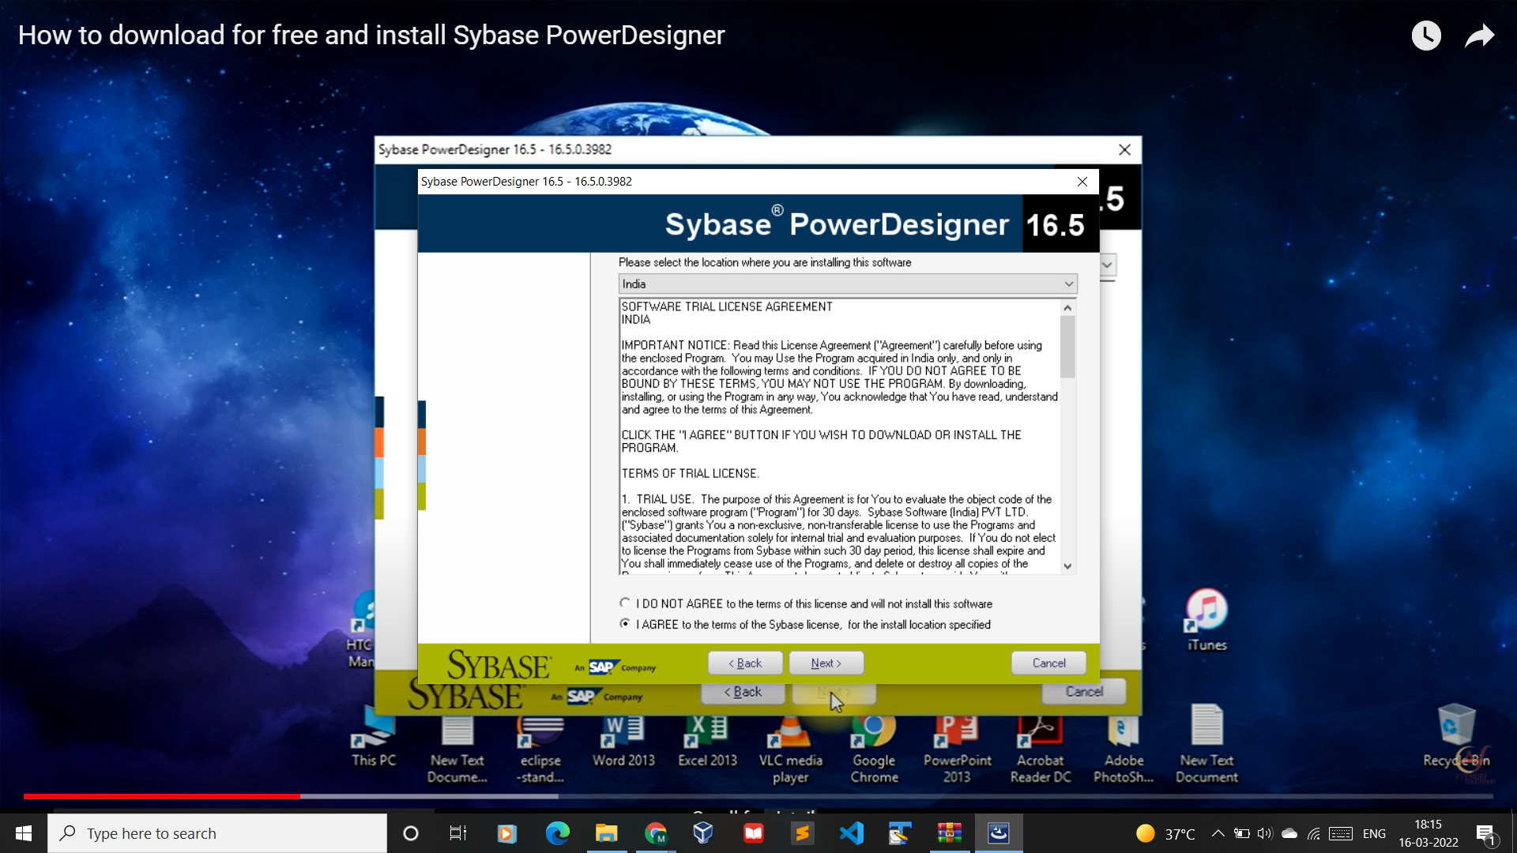

Slide 45

Paste in path -> Sybase -> PowerDesigner

Slide 46
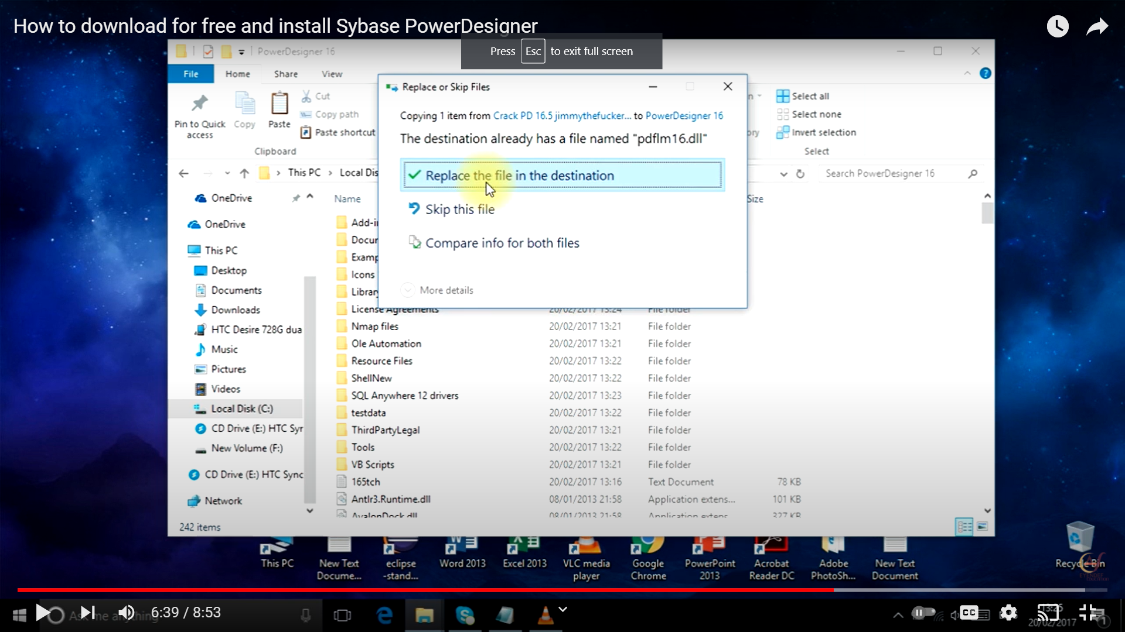
Replace the file

Slide 47
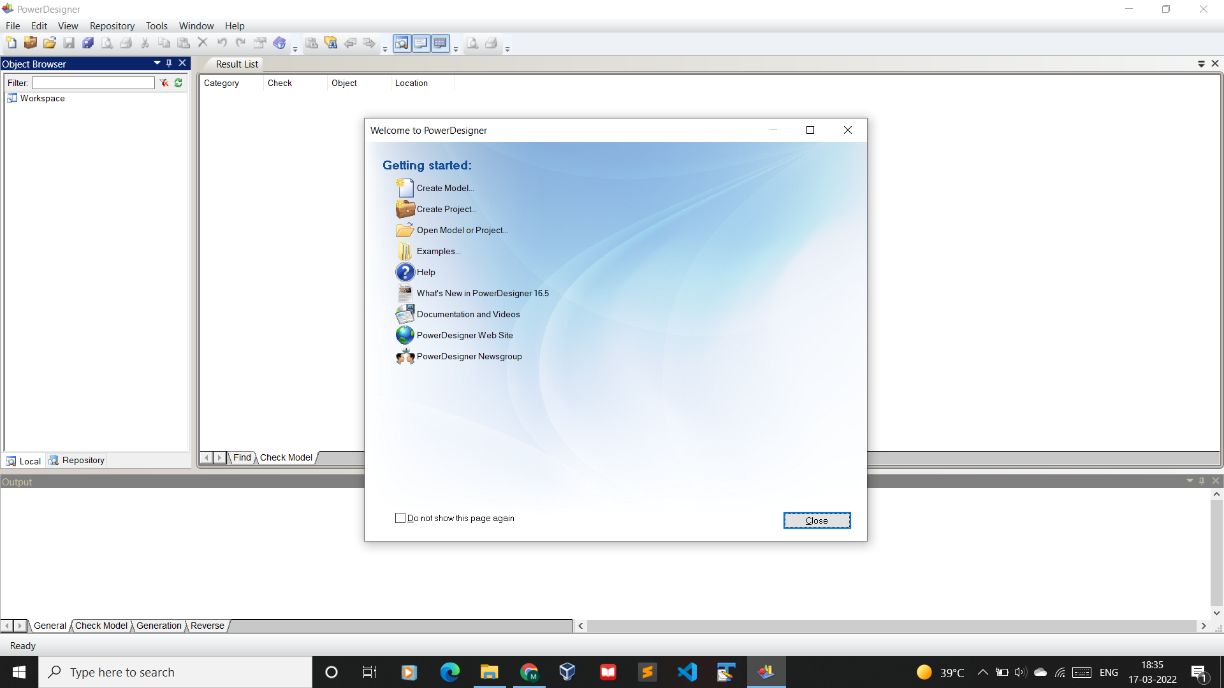
Create New Diagram

Slide 48
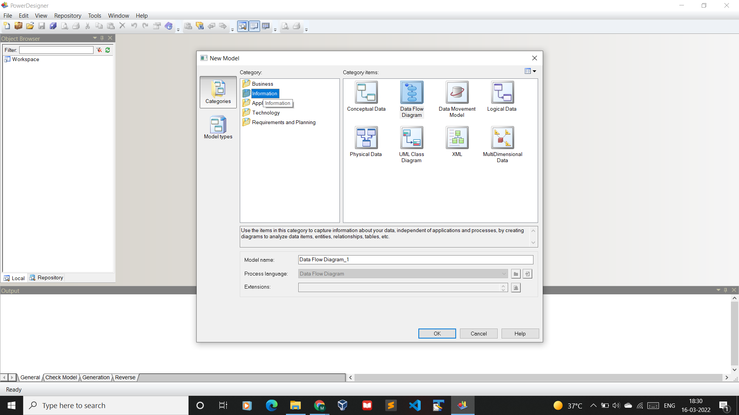

Slide 49
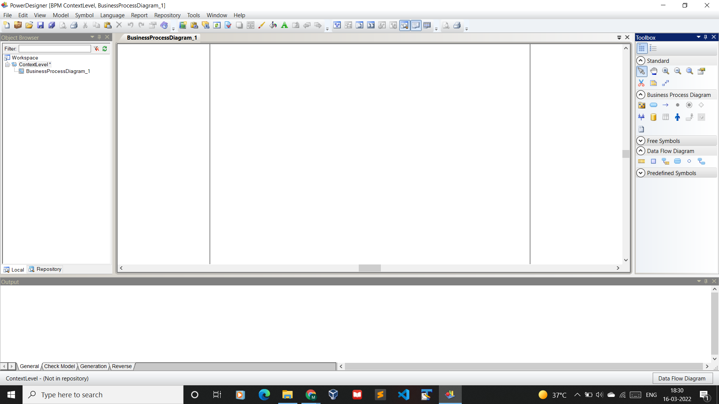
Dashboard

Slide 50
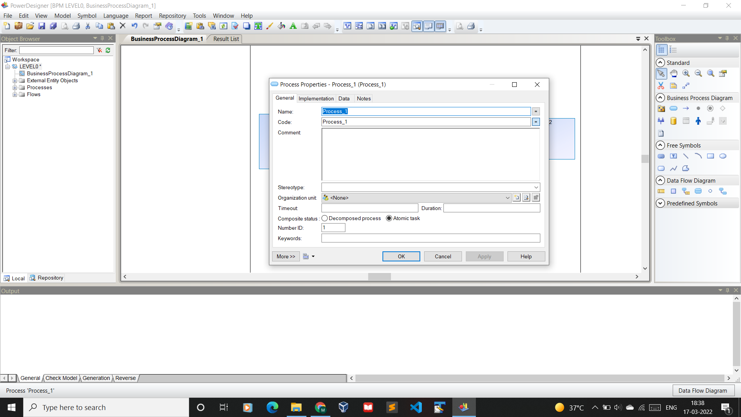
Process

Slide 51
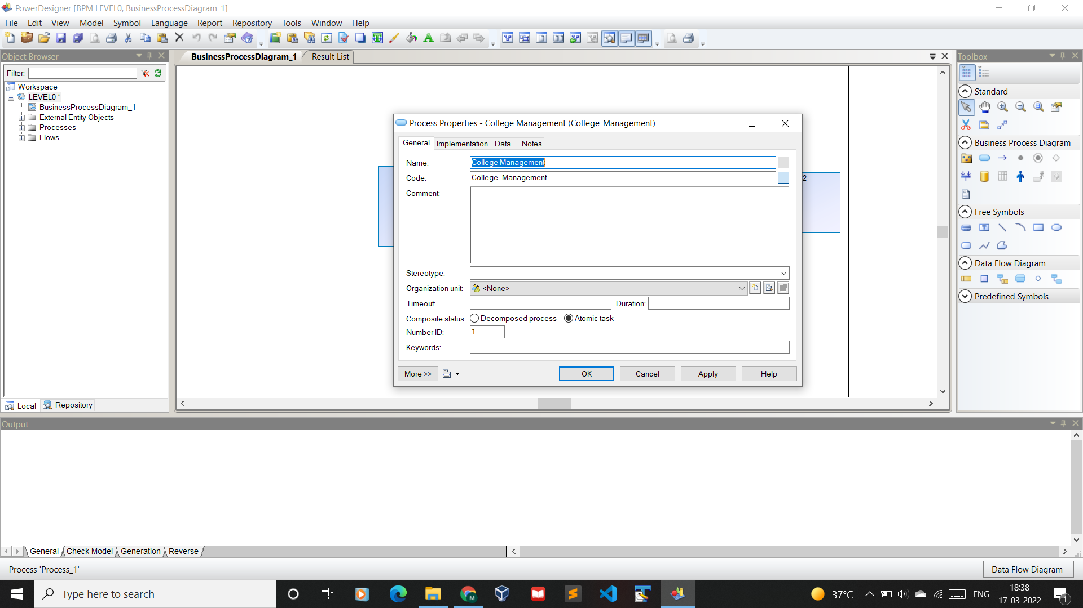

Slide 52
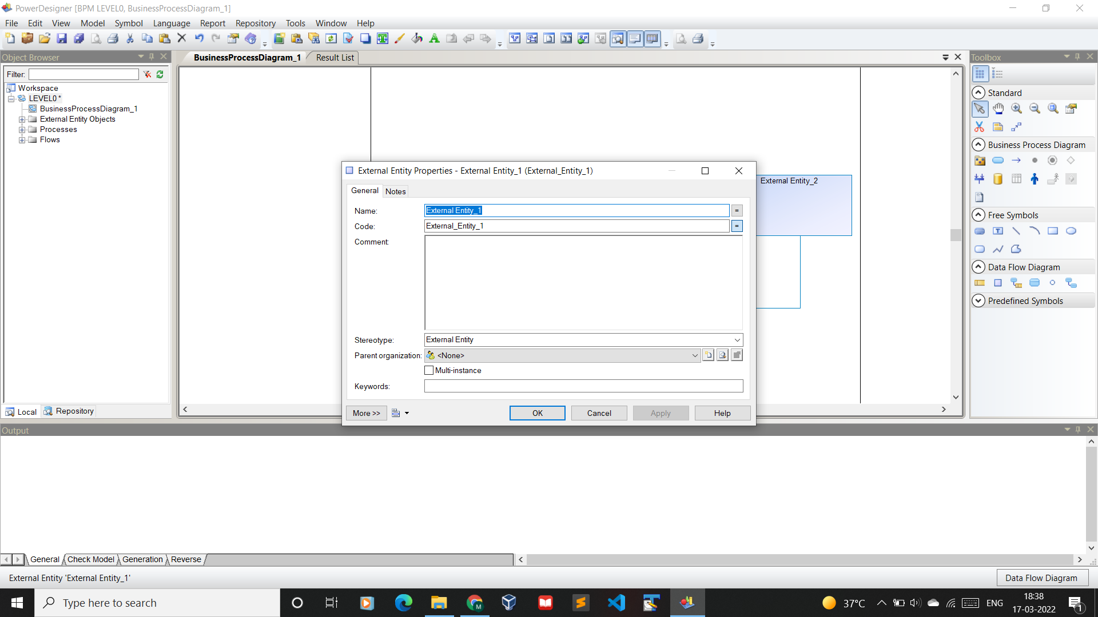
External Entity

Slide 53
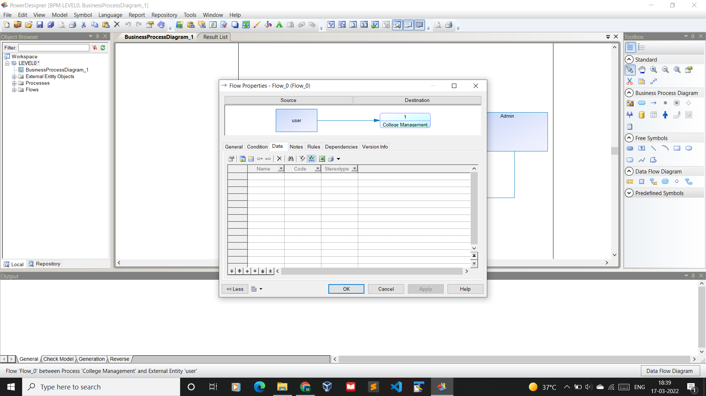
Data Flow External Entity to Process

Slide 54
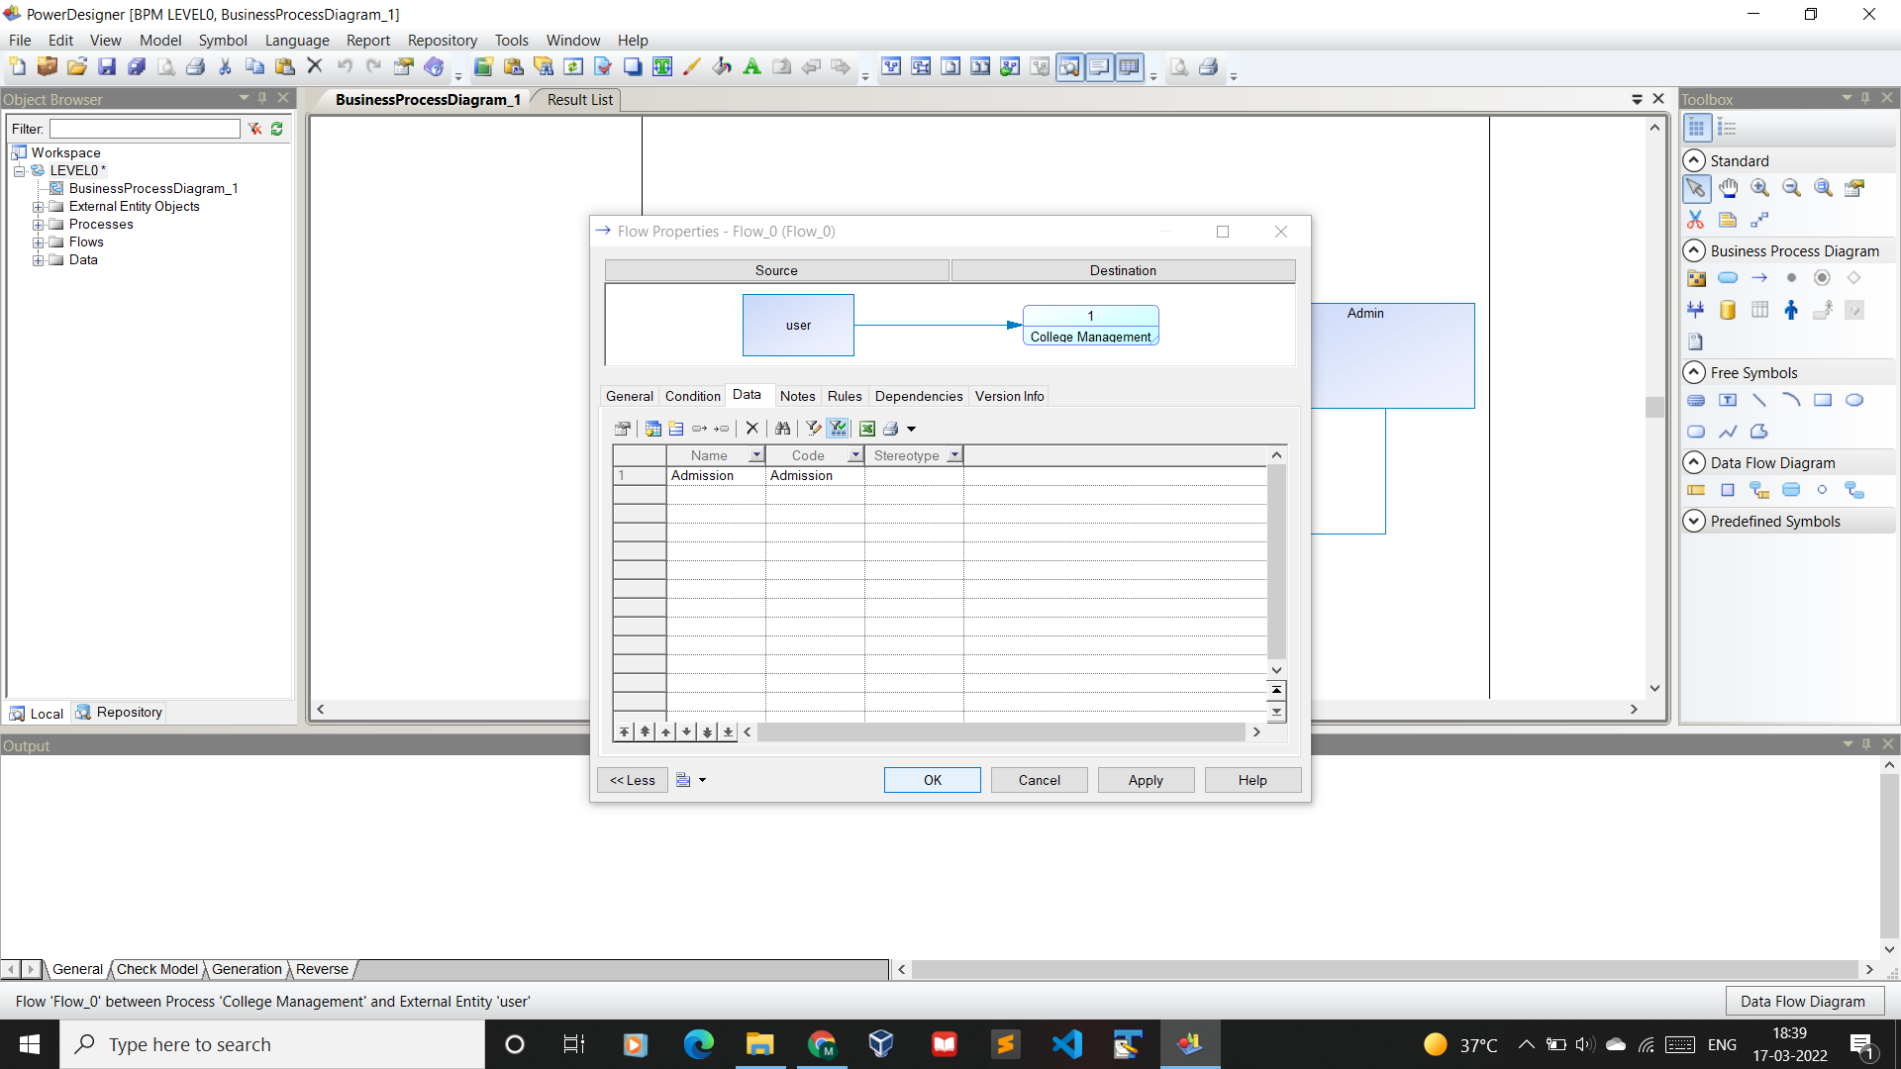
New Object for Data Flow

Slide 55
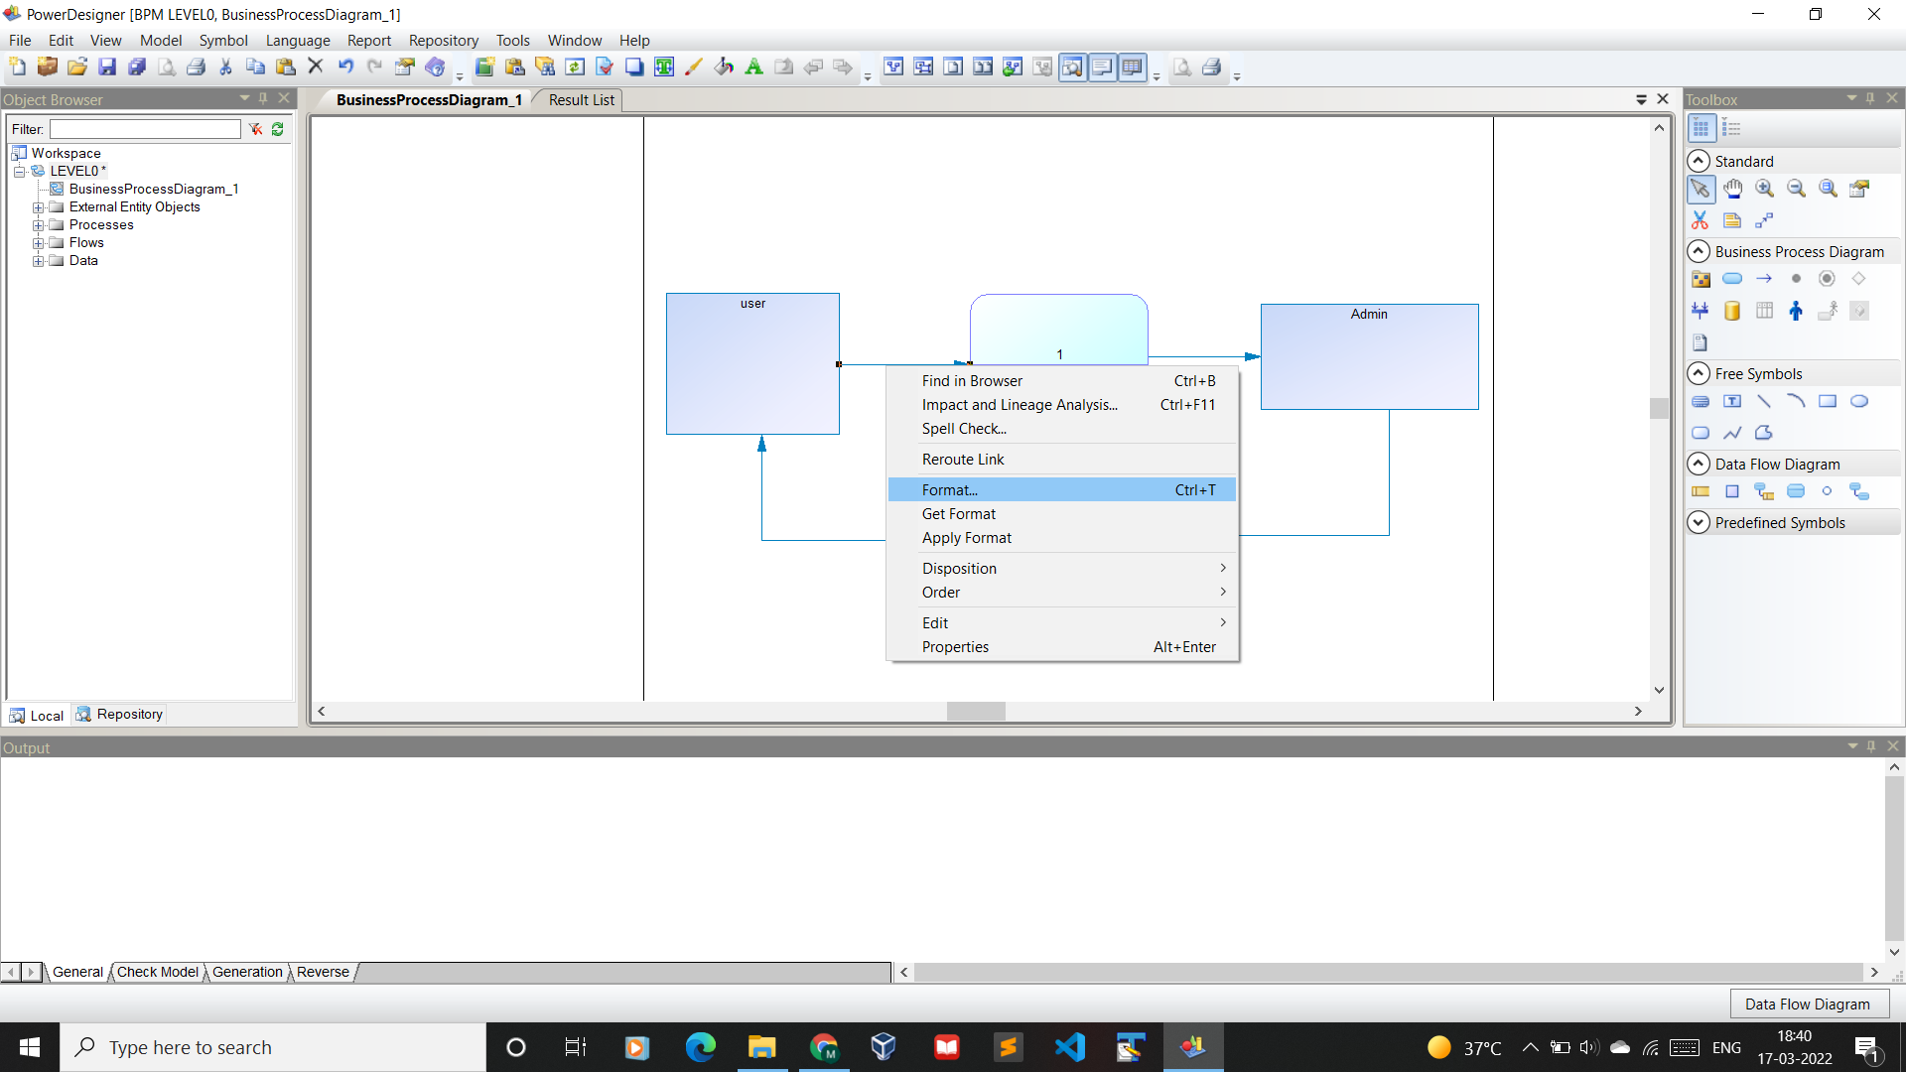
Data Flow Formatting

Slide 56
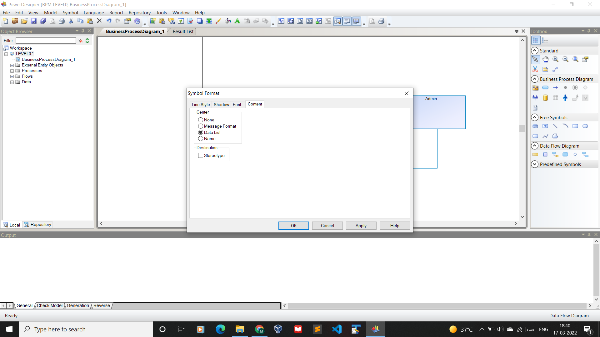

Slide 57
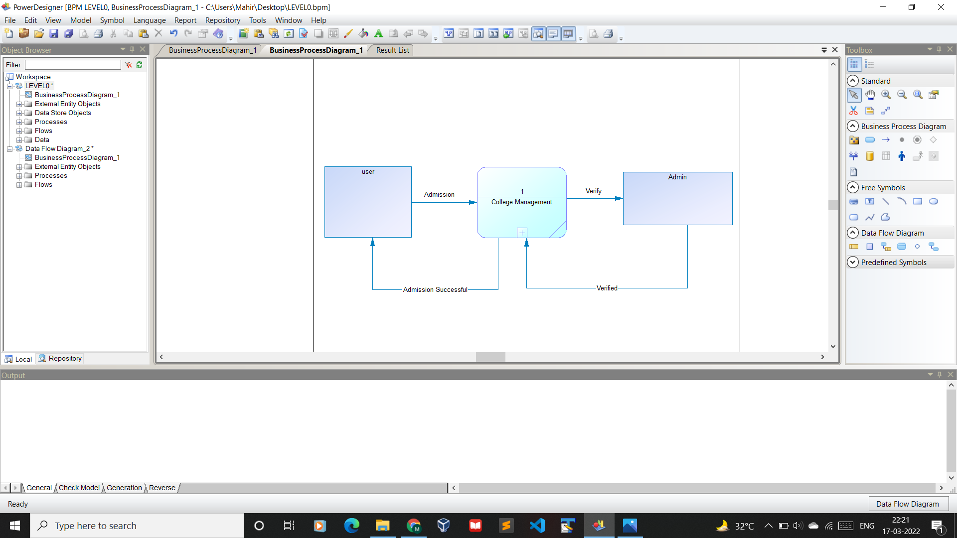
DFD Level 0

Slide 58
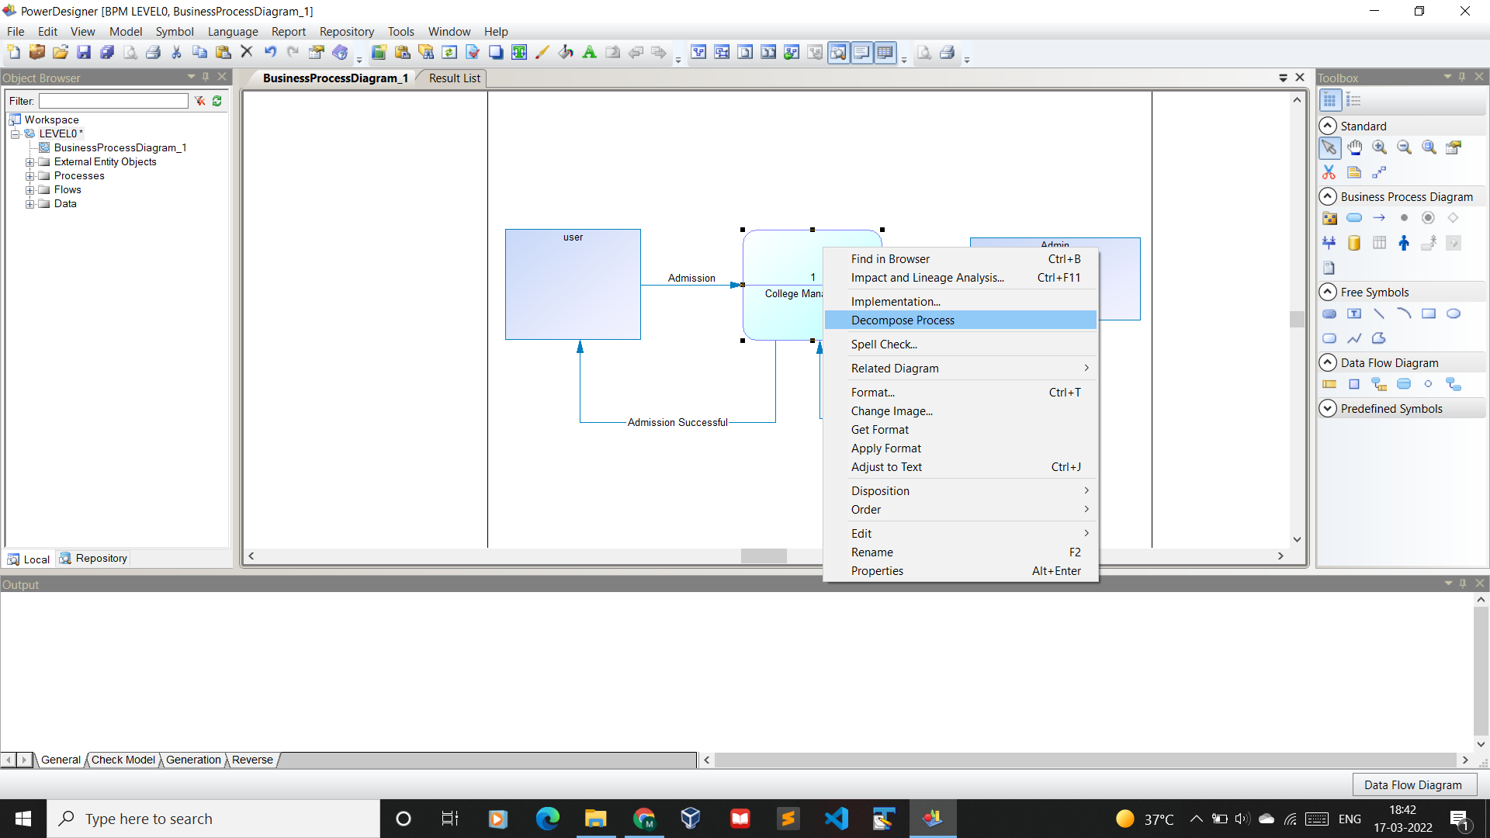
Decomposing Process to create balanced DFD

Slide 59
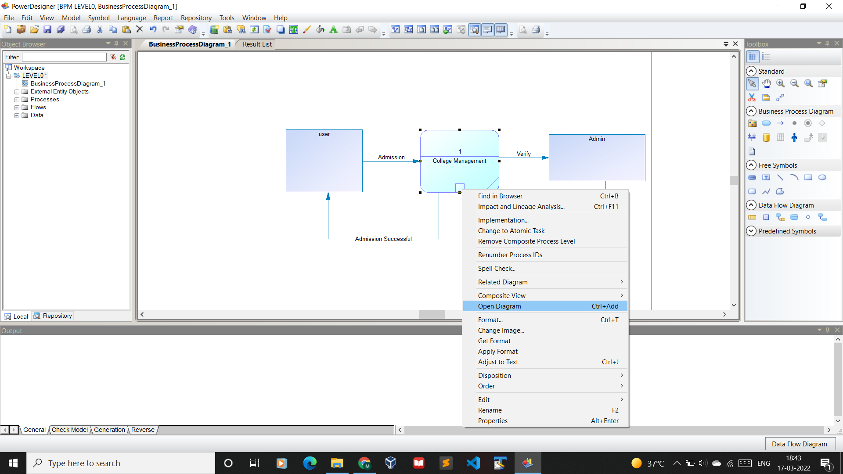

Slide 60
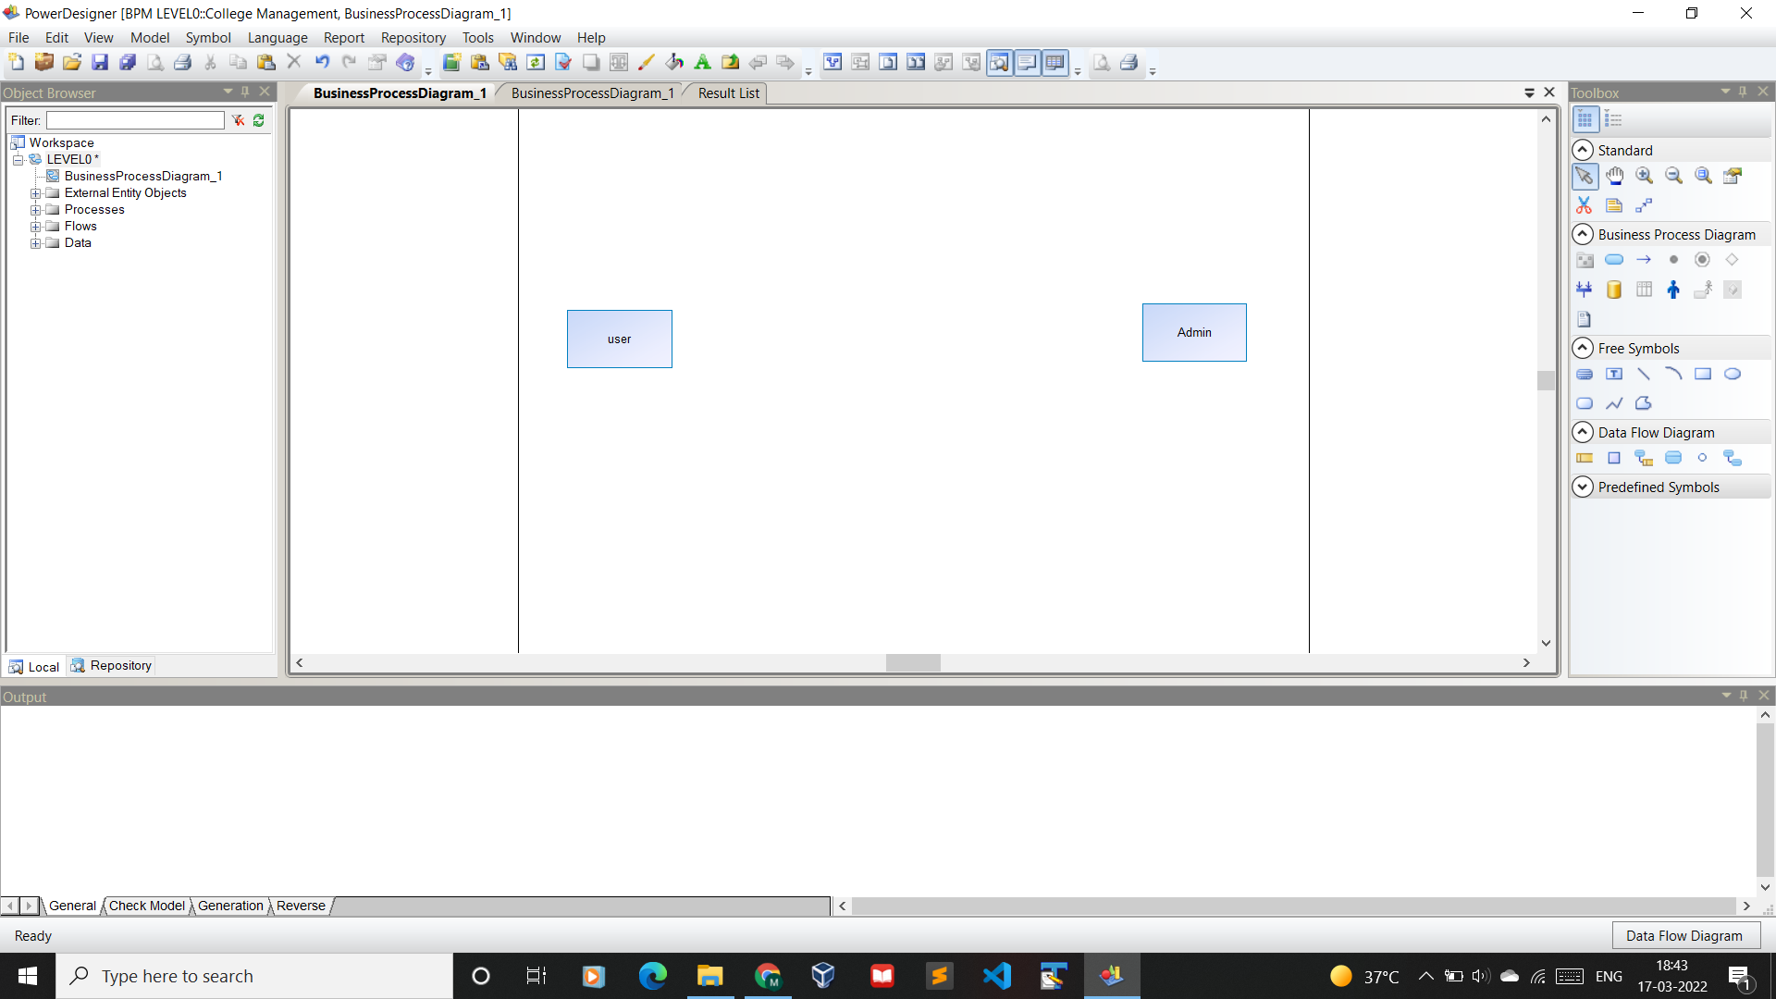
DFD Level 1

Slide 61
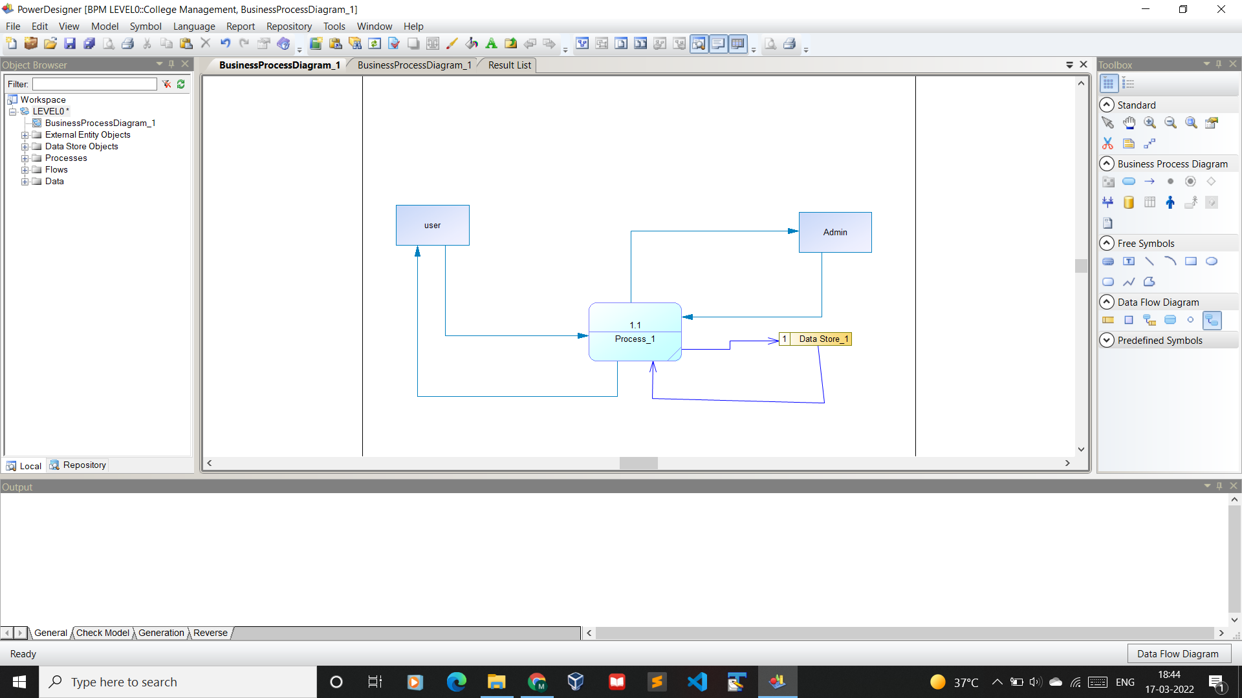

Slide 62
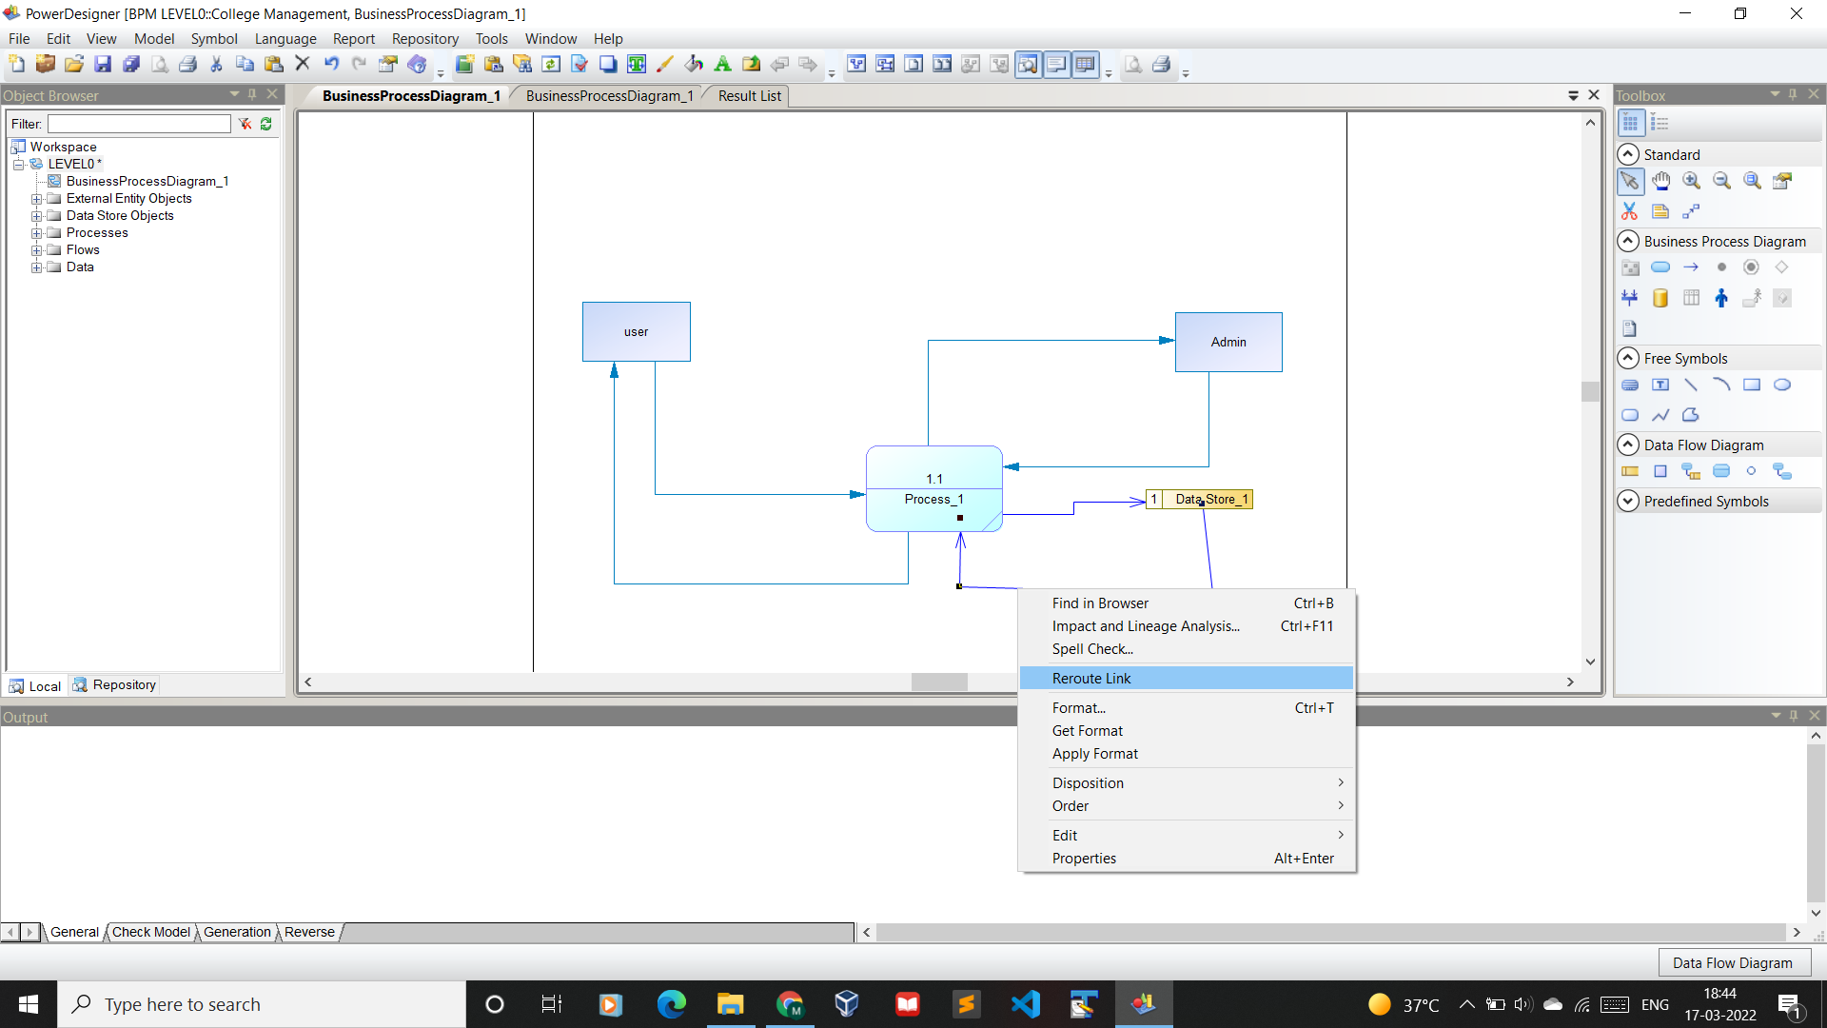
Reroute Link

Slide 63
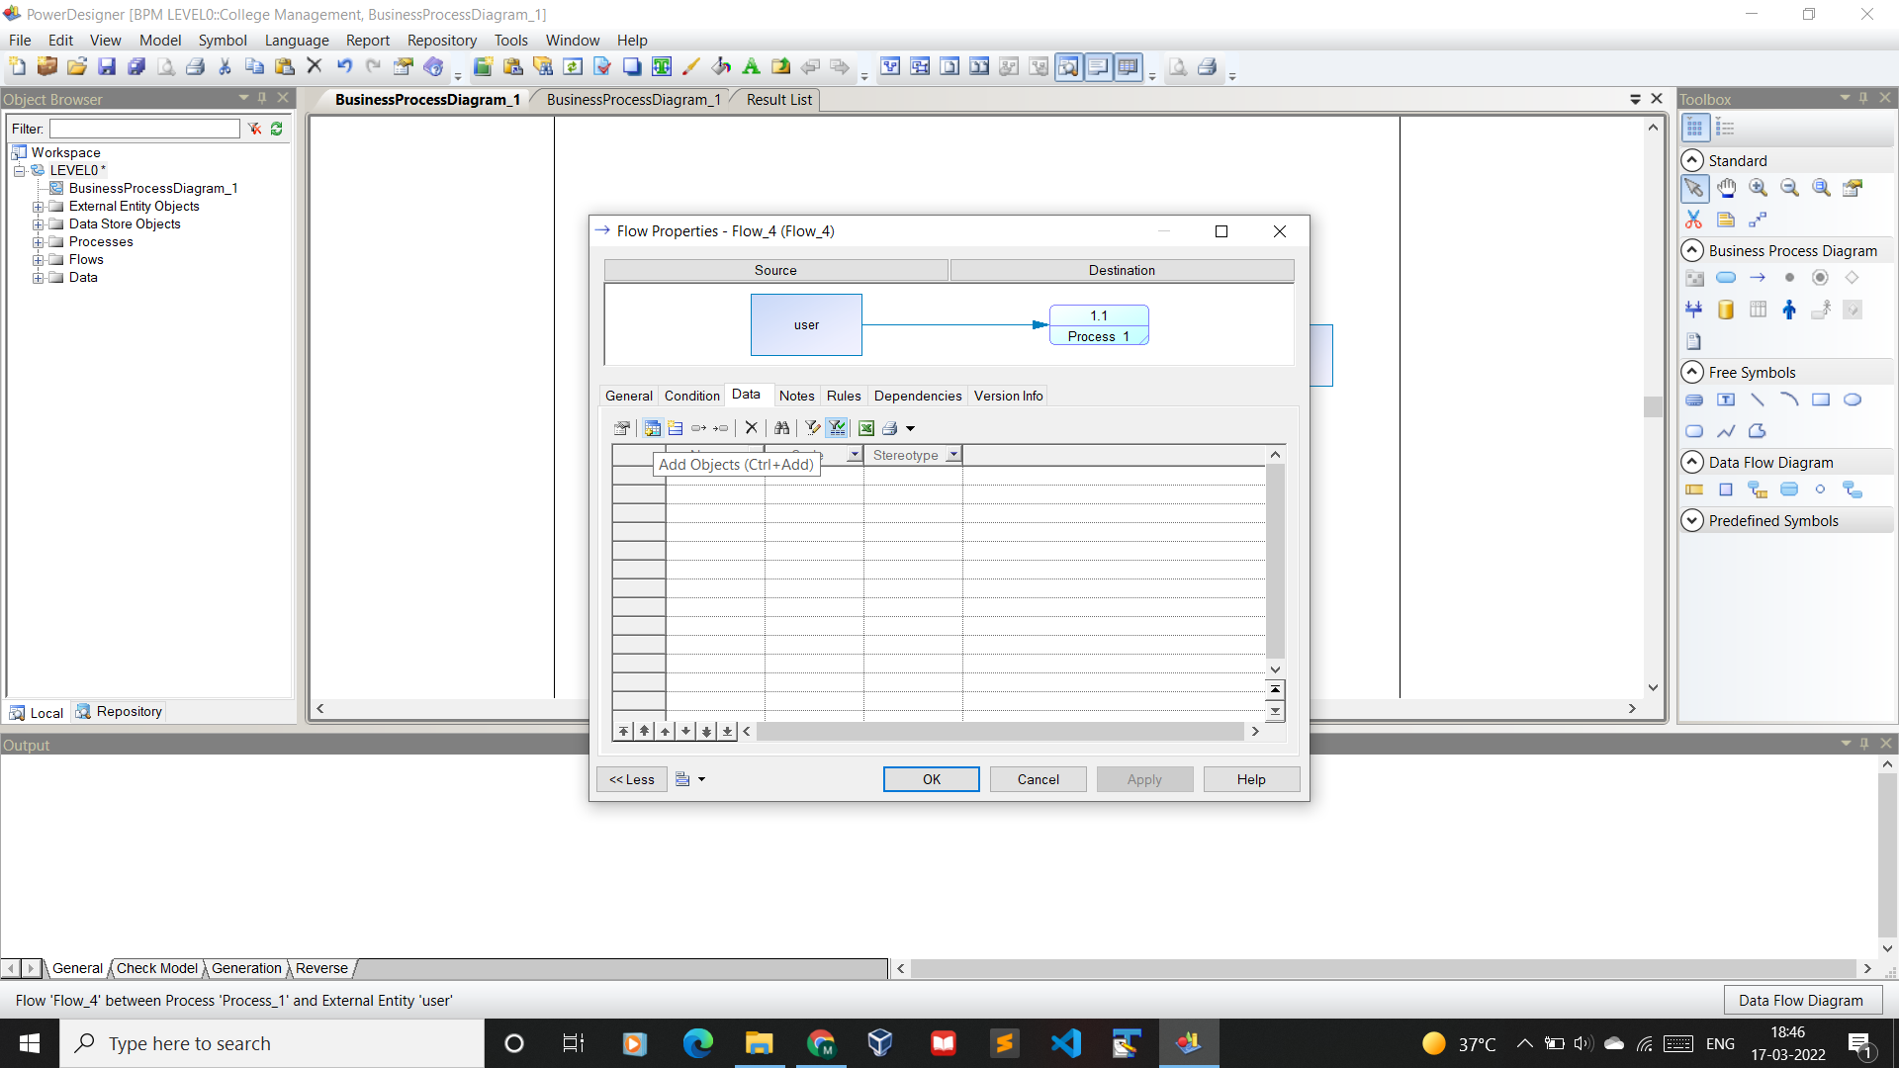
Object Relation Mapping

Slide 64
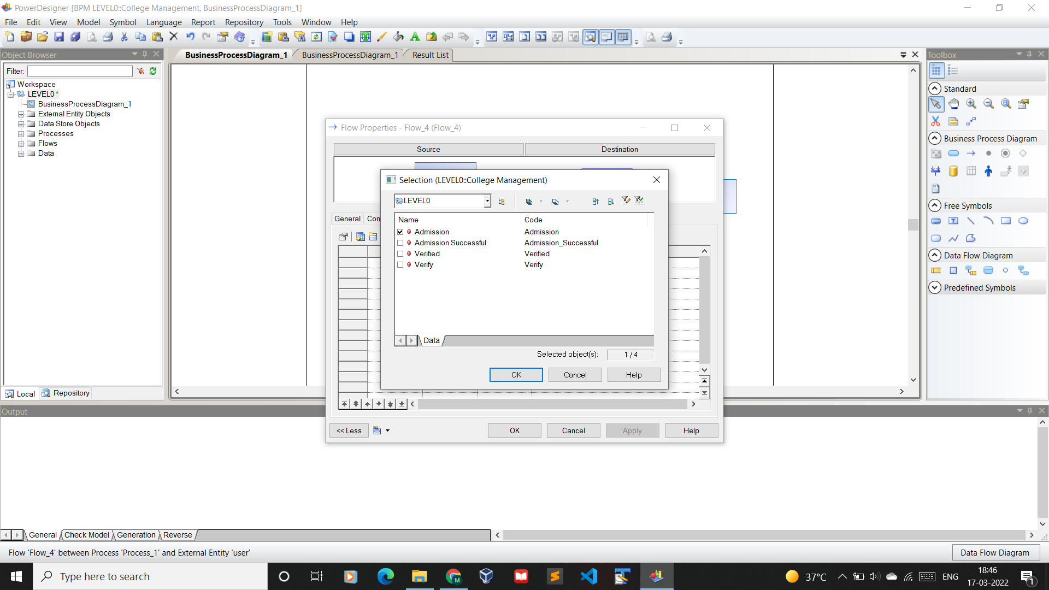

Slide 65


Slide 66


Slide 67
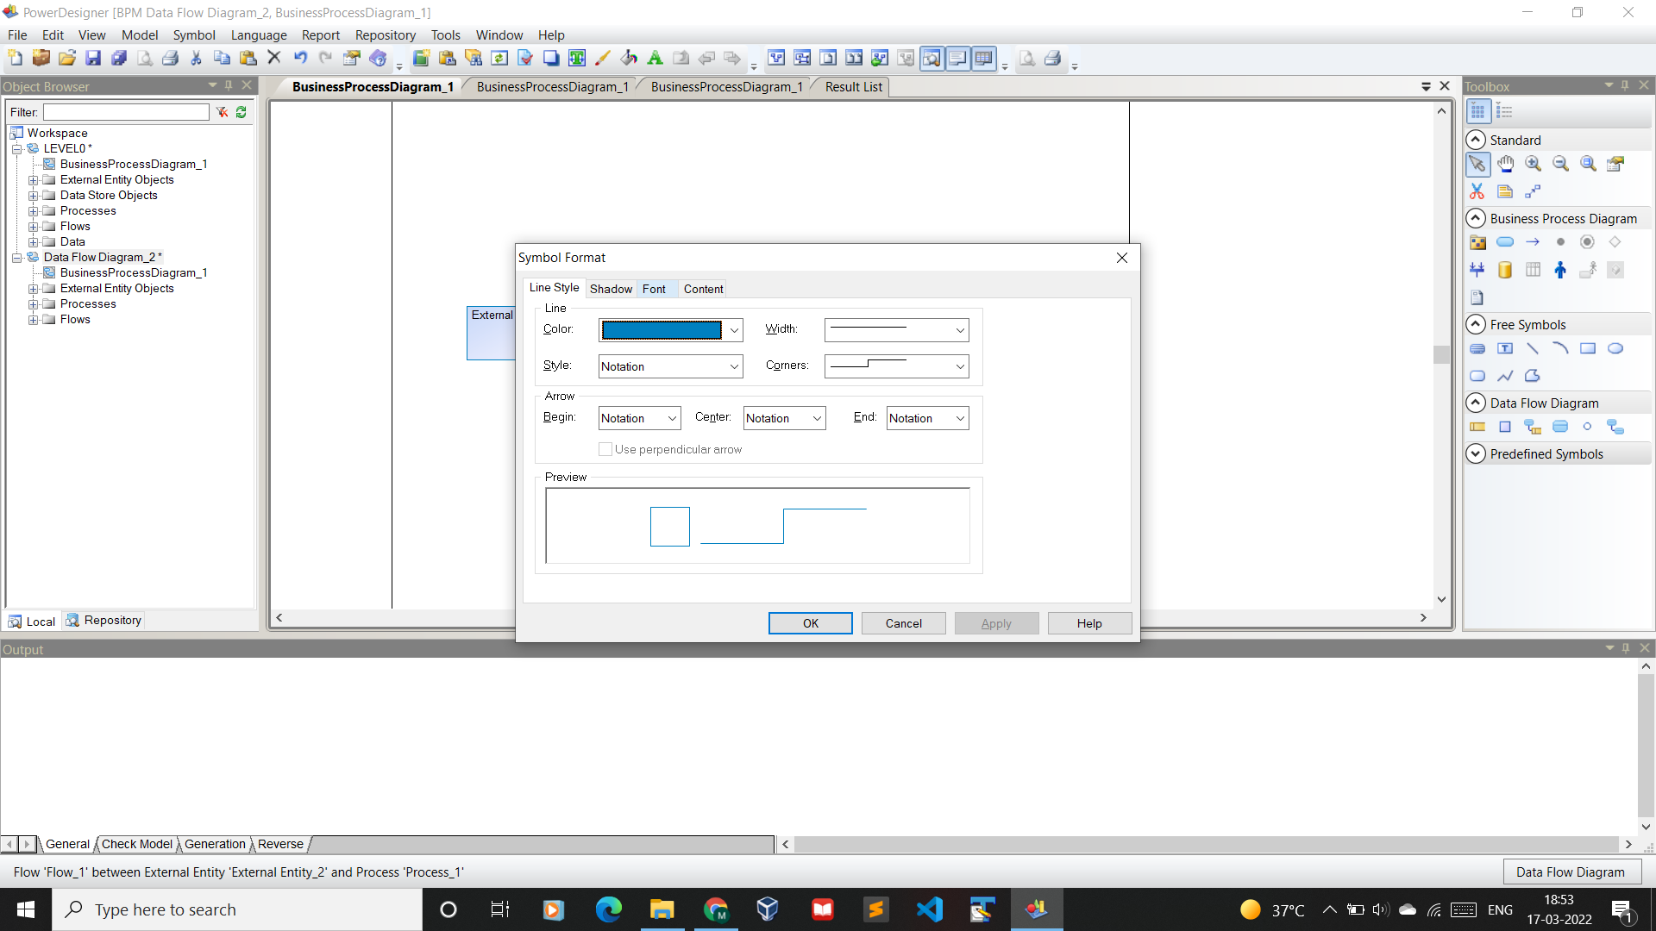
DataFlow Formatting

Slide 68
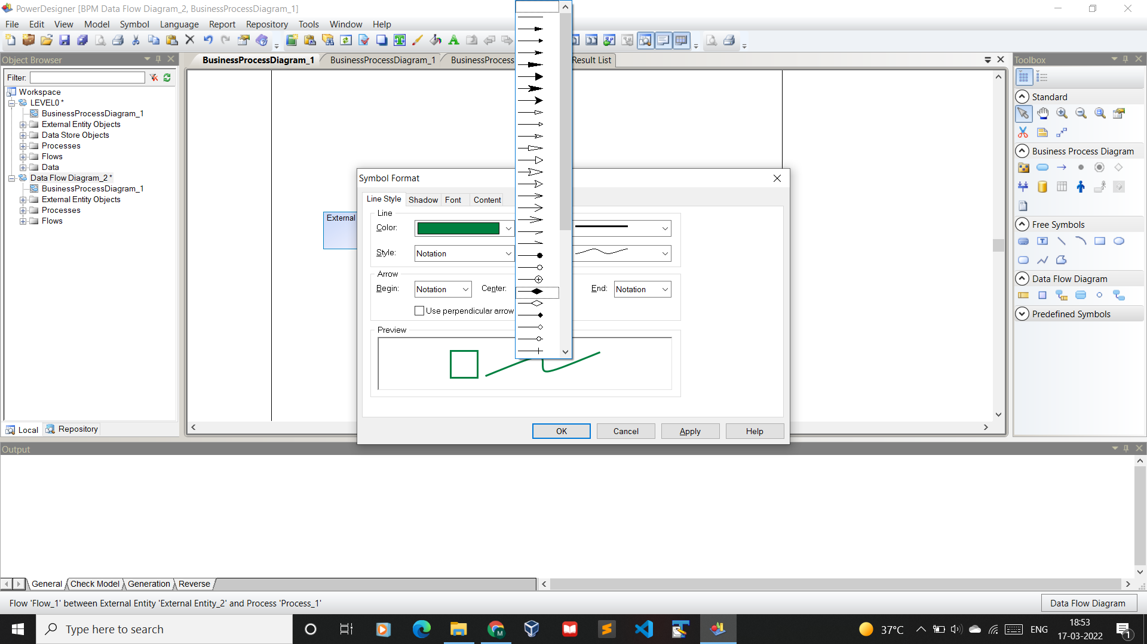

Slide 69
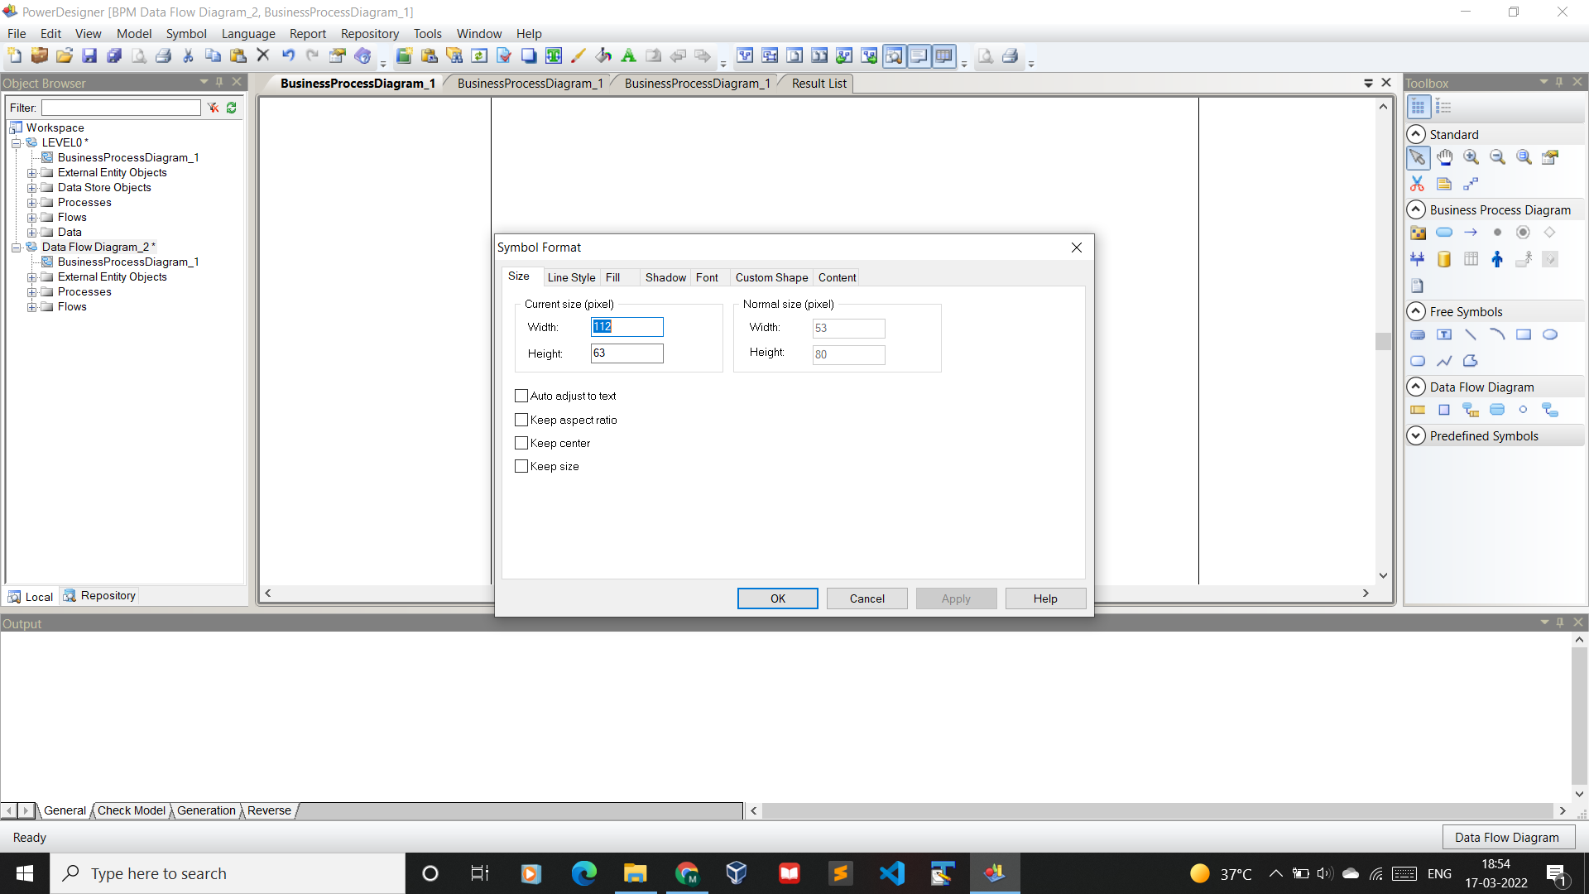
Process Options

Slide 70

Export as Image

